Slide 1
Mothering and the Neurobiology of the Child Maternal Gift Economy Salon, May 22, 2021
The Evolved Nest
Mary Tarsha, MA, Med, University of Notre Dame, EvolvedNest.org

Slide 2
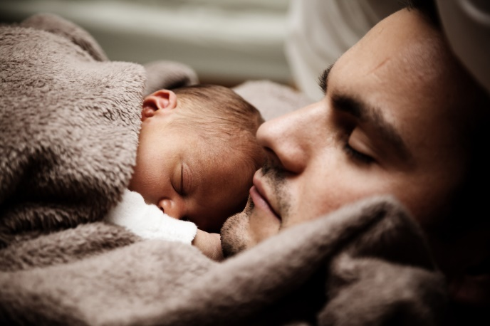
Body-brain-mind development
In early life…
Constant interaction between “nature” and “nurture”
Epigenetic effects of early experience for all systems
Developmentally plastic dynamic system
Caregivers co-construct
emotions and cognition TOGETHER (intertwined)
implicit self (social and moral)
social worldview
Human babies need “a womb with a view” (exterogestation)
(Montagu, 1978; Schore; Stern; Trevarthen; Tomkins)
EvolvedNest.Org

Slide 3
The Evolved Nest Provides Wellness Informed Care
9-Healing Practices
1-Soothing Perinatal Experiences
8-Nature Connection
2-On-Request
Breastfeeding
7-Responsive Relationships
Evolved
Nest
3-Positive, moving (no negative) touch
6-Allomothers
5-Self-Directed Social Play
4-Positive Climate
EvolvedNest.Org

Slide 4
1. Soothing Prenatal and Perinatal Experiences
Ability to conceive, carry and delivery a baby is dependent upon numerous biological systems (Bowers & Yehuda, 2016)
Endocrine system: oxytocin, endorphins, epinephrine, norepinephrine
Hypothalamus-pituitary-adrenal axis (HPA) functioning: Cortisol
Autonomic System
Prior experiences of generations before and Mother’s own life history influence Mother’s biological systems (McEwen, 2019)
These influence the neurobiology of the developing baby both in utero and postnatally (Gray et al., 2017)
To carry and give birth to an infant is part of a larger set of experiences

Slide 5
1. Soothing Prenatal and Perinatal Experiences
Common practices in US can stress the baby and disrupt development and bonding
Interference with timing (babies vary by 55 days in womb)
Labor drugs (can drug the baby for weeks),
Medical routines and environment stress the child (e.g., smells, bright lights, rough treatment, extensive separation of mom and baby, vaccination, circumcision)
Mother–infant entrainment affected physiologically and psychologically
Buckley, 2015; Liu et al., 2007
EvolvedNest.Org

Slide 6
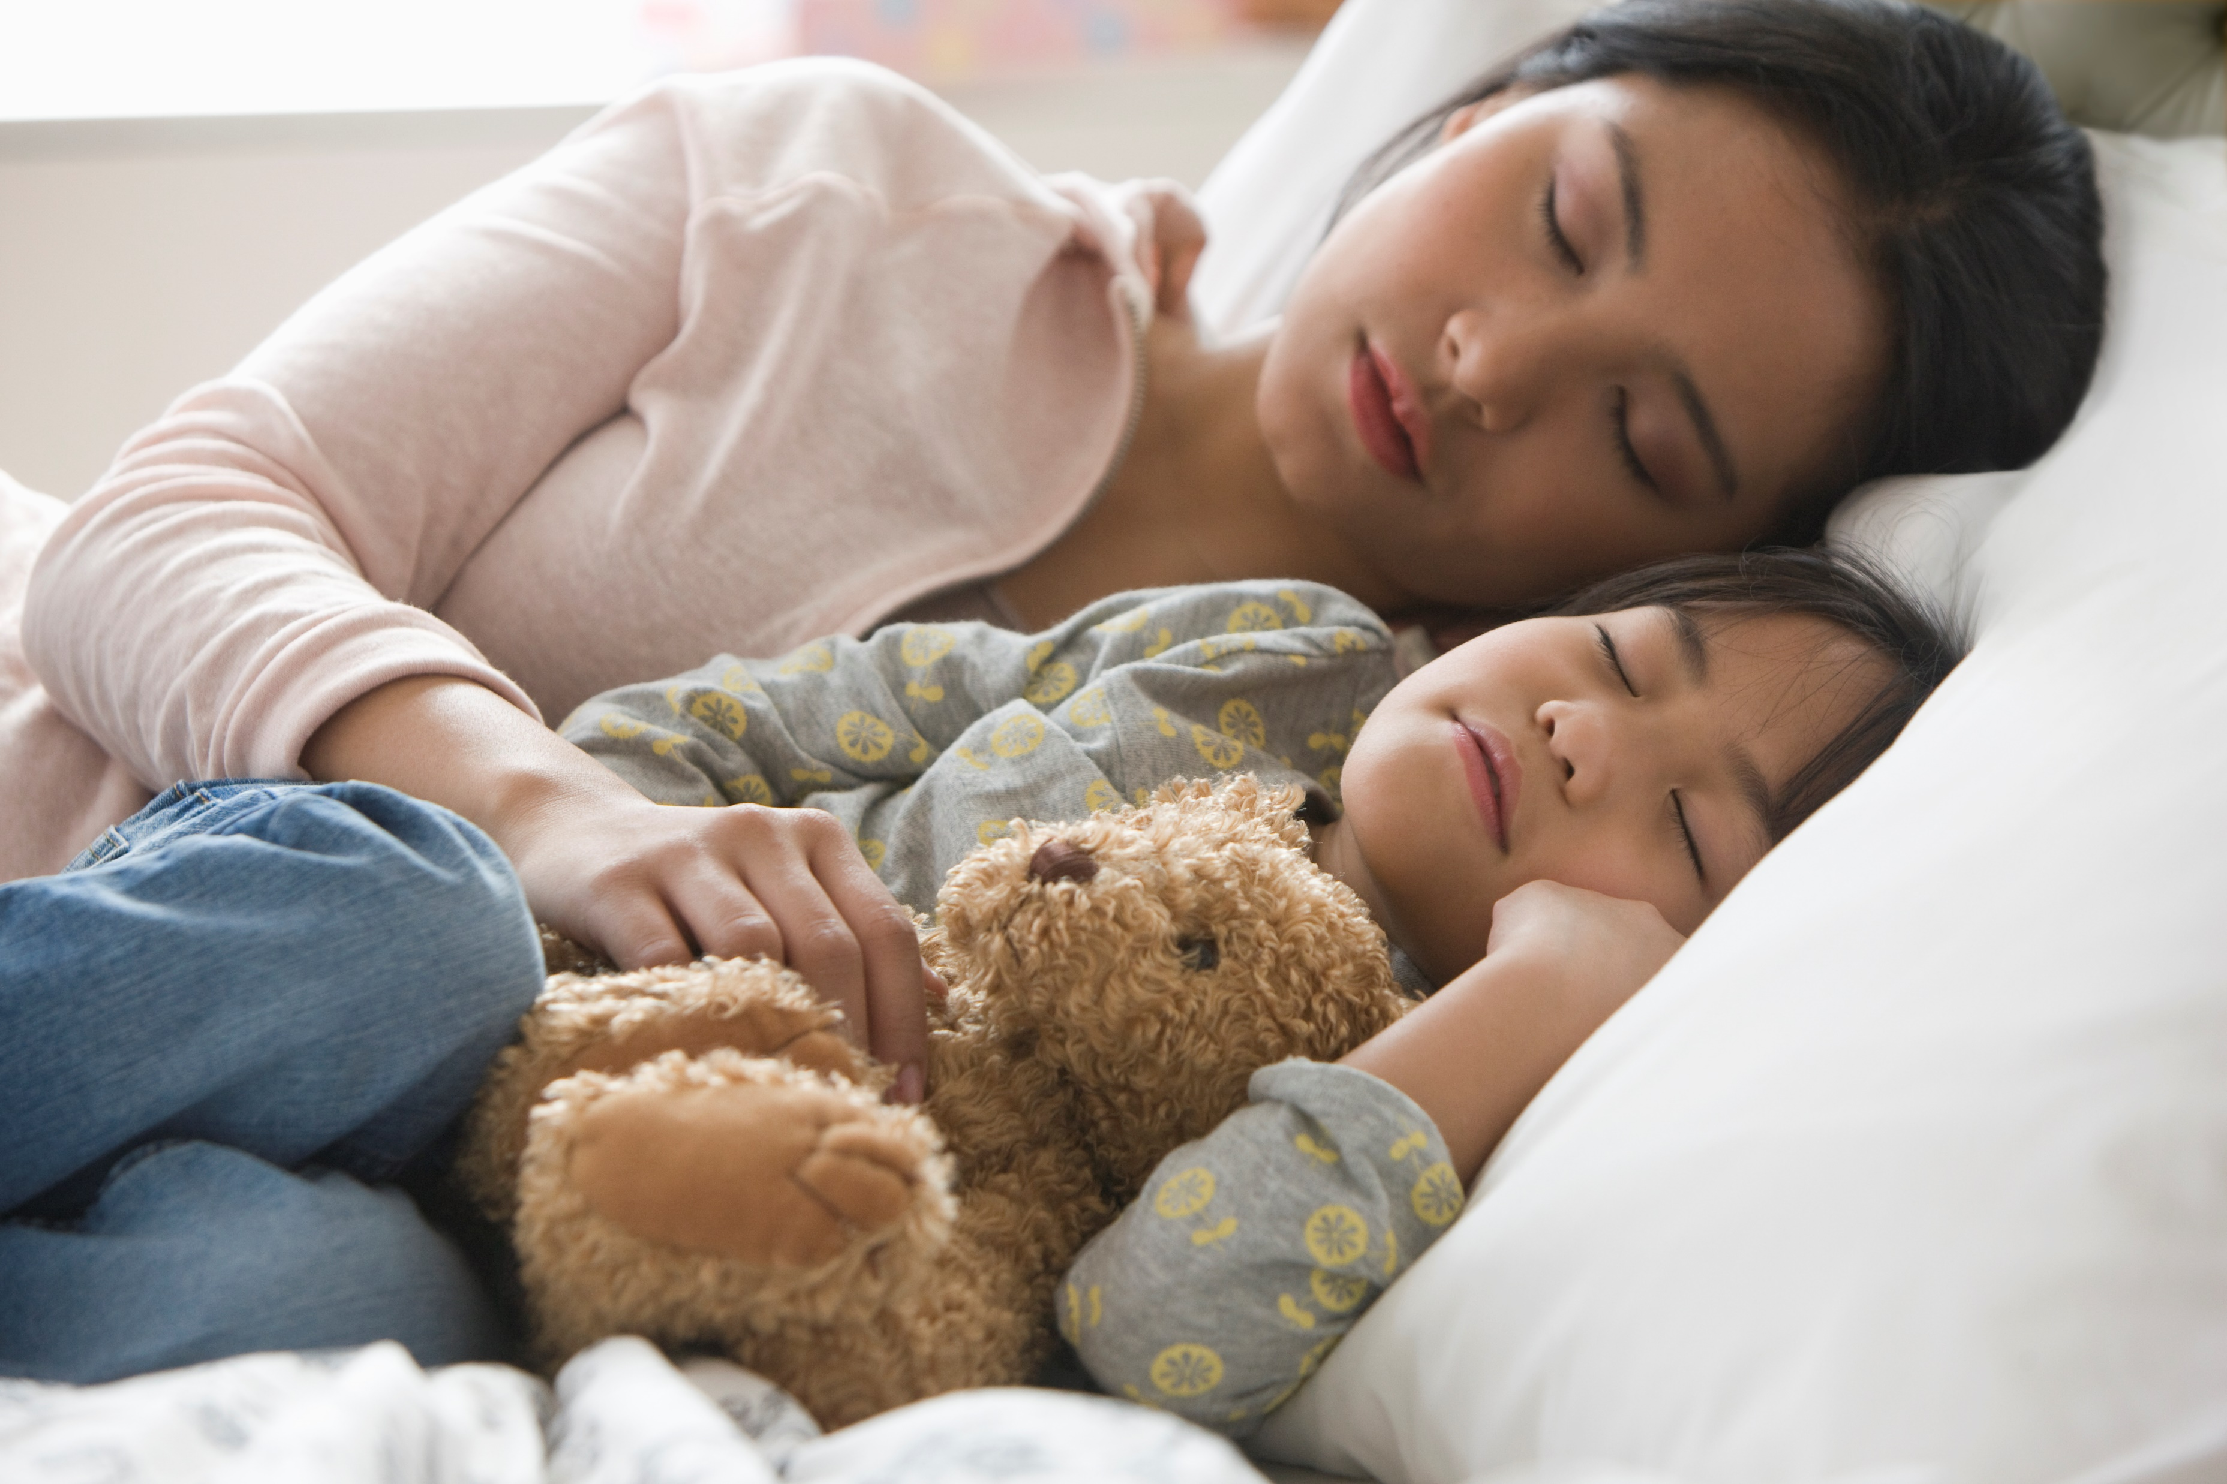
Maternal Presence Matters for Brain Development
Normal development requires neural sculpting and shaping of connections between neurons
This type of sculpting is dependent upon sensory experience
For mammals these sensory experiences come from feeding, nurturing, soothing

Slide 7
Maternal Presence Matters for Brain Development
Rat pups' brain activity (electroencephalography; EEG) when the mother present/absent
Maternal absence decreased cortical synchrony
based upon noradrenergic mechanisms (neurotransmitters responsible for flight or fight)
Conclusion: In the first months and years of life, maternal presence influences the infant brain
Sarro, Wilson and Sullivan (2014)
Simple presence of the mother shapes infant brain activity (Drury, Sanchez & Gonzalez, 2016)

Slide 8
Heart Math: Field Resonance
The most calming type of physical contact when one is distressed is the chest-to-chest, heart-to-heart hug.

Slide 9
The Evolved Nest Provides Wellness Informed Care
9-Healing Practices
1-Soothing Perinatal Experiences
8-Nature Connection
2-On-Request
Breastfeeding
7-Responsive Relationships
Evolved
Nest
3-Positive, moving (no negative) touch
6-Allomothers
5-Self-Directed Social Play
4-Positive Climate
EvolvedNest.Org

Slide 10
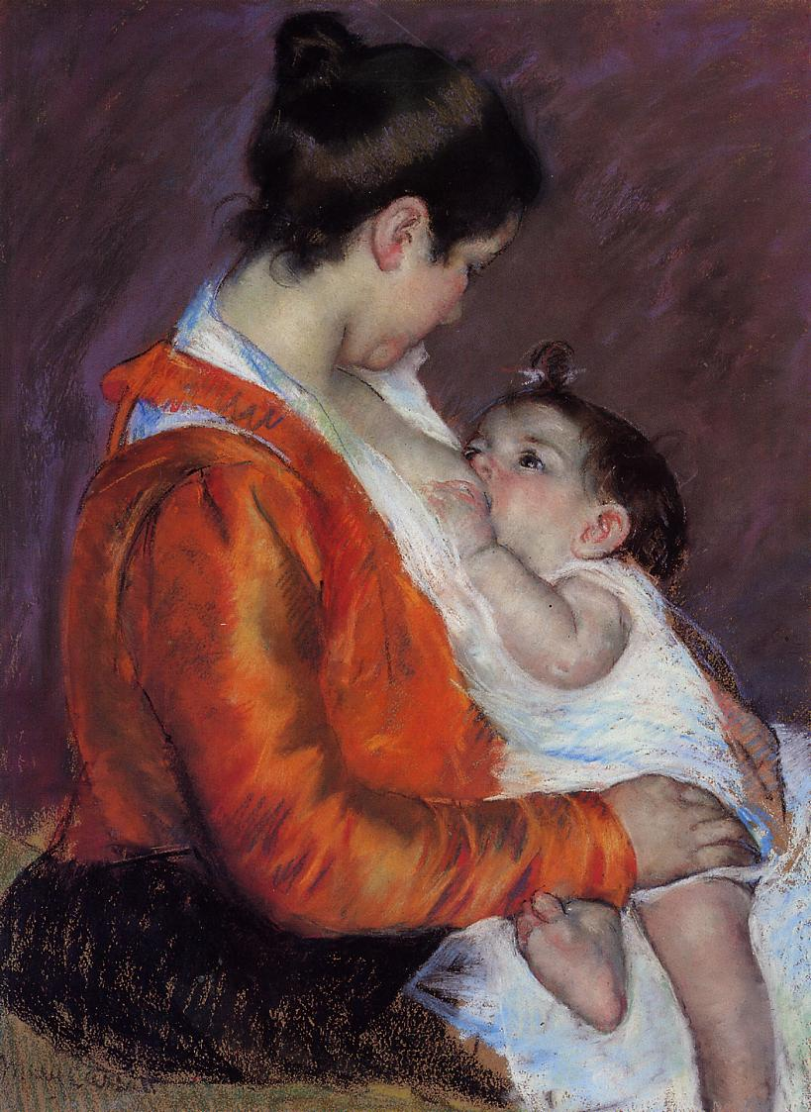
2. Breastfeeding
Higher IQ and Executive Functioning Skills
persists into adulthood (Shafai, Mustafa, Compsos, & Niake, 2018)
Analgesic (Gray, Miller, Philipp, & Blass, 2002)
Oligosaccharides (sugars)→ Antimicrobial and protective biofilm (Ackerman et al., 2017)
Larger brain size
Greater myelination of white matter
Observational studies: breastfed babies significantly greater cognitive and behavioral development
EvolvedNest.Org

Slide 11
The Evolved Nest Provides Wellness Informed Care
9-Healing Practices
1-Soothing Perinatal Experiences
8-Nature Connection
2-On-Request
Breastfeeding
7-Responsive Relationships
Evolved
Nest
3-Positive, moving (no negative) touch
6-Allomothers
5-Self-Directed Social Play
4-Positive Climate
EvolvedNest.Org

Slide 12
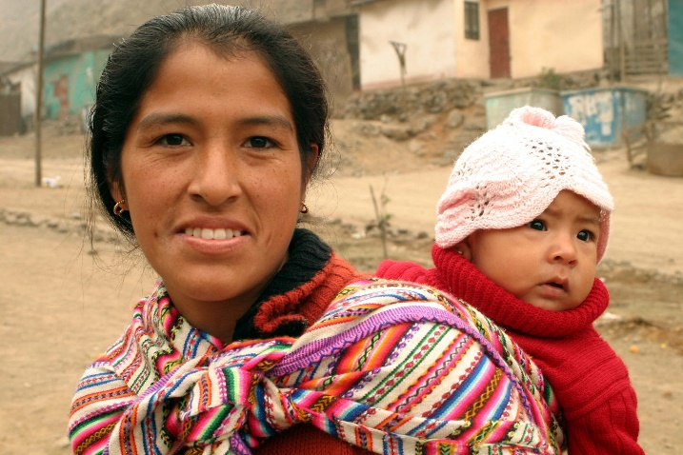
3. Physical Touch and Affection
Mammals need touch to grow and synthesize DNA and promotes:
Healthy sleep cycles
Adaptive behavioral arousals
Exploratory activities
Social and cognitive functioning
Calming
Long lasting health benefits
Prevents excessive stress
Prevents hippocampal dysfunction
Prevents eventual depression
Tiffany Field; James McKenna; Jaak Panksepp Saul Schanberg
Negative Touch has long term negative effects:
“spanking is empirically similar to physical and emotional abuse” (Affi et al., 2017, p. 25).

Slide 13
The Evolved Nest Provides Wellness Informed Care
9-Healing Practices
1-Soothing Perinatal Experiences
8-Nature Connection
2-On-Request
Breastfeeding
7-Responsive Relationships
Evolved
Nest
3-Positive, moving (no negative) touch
6-Allomothers
5-Self-Directed Social Play
4-Positive Climate
EvolvedNest.Org

Slide 14
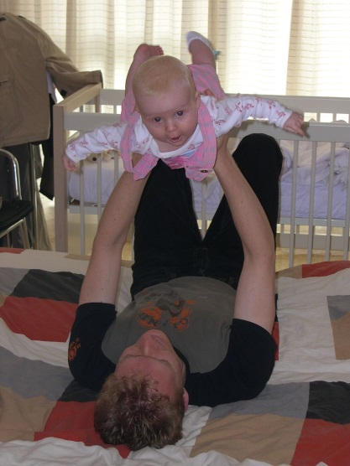
4. Positive Social Climate
More positive than negative emotions
More joy, serenity, expansiveness
Less sadness, anger, fear, humiliation
Research: More positive emotion in childhood, adults are more secure, mentally healthier, less distressed
Feels loved, cherished, appreciated
Creates positive reactions in others
Has deep friendships
https://commons.wikimedia.org/wiki/File%3AMay_pole_dance_at_Ohio_State_Normal_College_Model_School_May_Day_celebration_1911_(3191566654).jpg
By Snyder, Frank R. Flickr: Miami U. Libraries - Digital Collections [No restrictions], via Wikimedia Commons
EvolvedNest.Org

Slide 15
The Evolved Nest Provides Wellness Informed Care
9-Healing Practices
1-Soothing Perinatal Experiences
8-Nature Connection
2-On-Request
Breastfeeding
7-Responsive Relationships
Evolved
Nest
3-Positive, moving (no negative) touch
6-Allomothers
5-Self-Directed Social Play
4-Positive Climate
EvolvedNest.Org

Slide 16
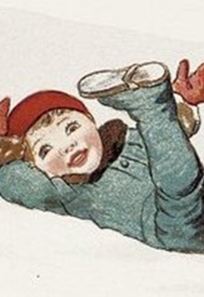
5. Self-Directed Social Play
Facilitates emotion regulation development, including aggressive urges (Panksepp et al., 2003; van den Berg et al., 1999)
Influences gene expression profiles (Burgdorf, Kroes, Beinfeld, Panksepp, & Moskal, 2010)
Fosters brain development (Gordon, Kollack-Walker, Akil, & Panksepp, 2002; Gordon, Burke, Akil, Watson, & Panksepp, 2003; Panksepp, 2007; van den Berg et al., 1999)
Painting: The author died in 1919, so this work is in the public domain in its country of origin and other countries and areas where the copyright term is the author's life plus 95 years or less.
EvolvedNest.Org

Slide 17
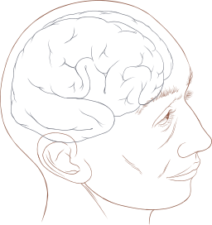
Right hemisphere development dominant in early years: Play can re-grow it!
Evolved Nest: Moral Neuroeducation of Mind-Heart-Spirit
Self-regulation
Intersubjectivity & social pleasure
Emotional intelligence
Empathy
Beingness
Self transcendence
Higher consciousness
(See work of Allan Schore)
IMAGE: By Patrick J. Lynch, medical illustrator (Patrick J. Lynch, medical illustrator) [CC BY 2.5 (http://creativecommons.org/licenses/by/2.5)], via Wikimedia Commons; https://commons.wikimedia.org/wiki/File%3AHuman_head_and_brain_diagram.svg

Slide 18
The Evolved Nest Provides Wellness Informed Care
9-Healing Practices
1-Soothing Perinatal Experiences
8-Nature Connection
2-On-Request
Breastfeeding
7-Responsive Relationships
Evolved
Nest
3-Positive, moving (no negative) touch
6-Allomothers
5-Self-Directed Social Play
4-Positive Climate
EvolvedNest.Org

Slide 19
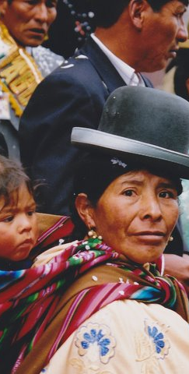
Allomothers/Alloparents Shape the Social Brain
Baby learns to be comfortable with lots of different people in terms of smell, voice, touch, and relational styles
Extended attachment
Less stranger anxiety
Improved perspective taking and theory of mind

Slide 20
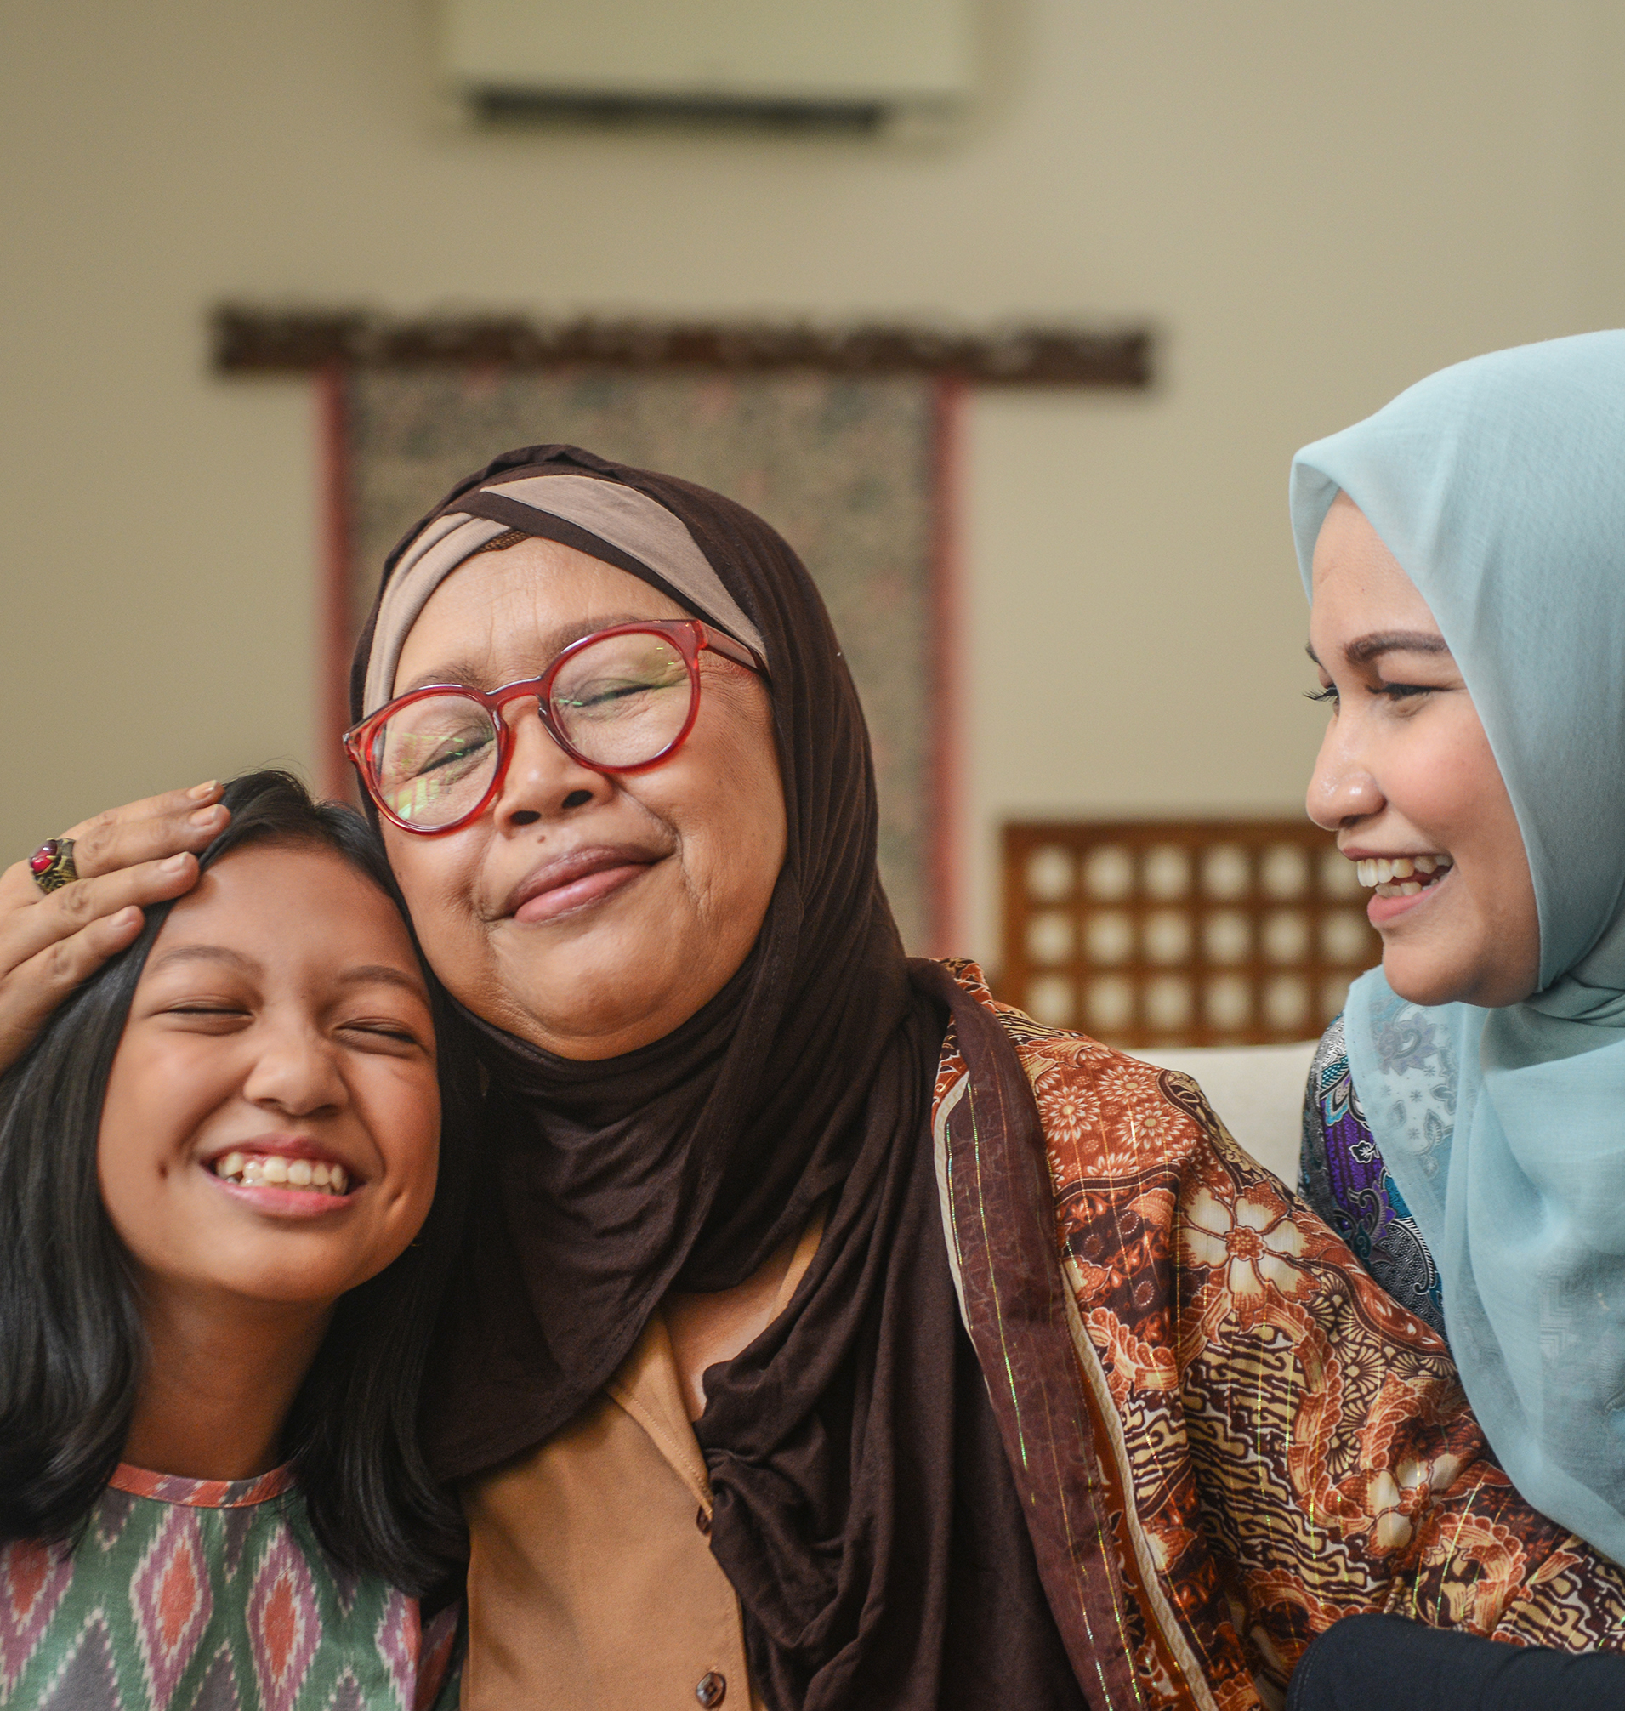
Allomothers and Alloparents
When parents are surrounded by a supportive community of alloparents, their knowledge and expectations about parenting increase
Stress surrounding parenting decreases, allowing for more positive rather than negative interactions (Serrano-Villar et al., 2017)
Increased wellbeing for both the parents and the child = Protective Factor (Hrdy, 2009)

Slide 21
The Evolved Nest Provides Wellness Informed Care
9-Healing Practices
1-Soothing Perinatal Experiences
8-Nature Connection
2-On-Request
Breastfeeding
7-Responsive Relationships
Evolved
Nest
3-Positive, moving (no negative) touch
6-Allomothers
5-Self-Directed Social Play
4-Positive Climate
EvolvedNest.Org

Slide 22
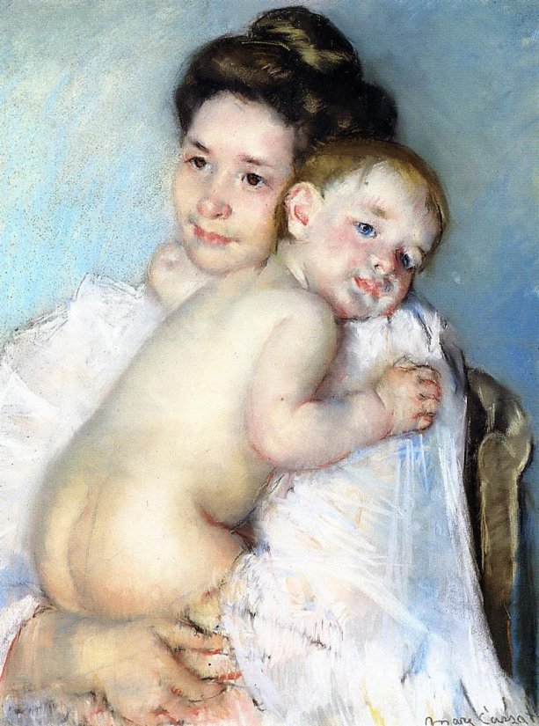
7. Responsive Relationships
Reciprocal communication
Synchrony and repaired dysynchrony
Mutual influence
Building of shared narratives
Meeting child’s needs in the moment
Mutual co-regulation
Establishes brain wiring, emotion regulation, and trajectory for habitual patterns
(e.g., Lewis et al., 2000; Schore, 1994; 2001; Trevarthen, 2005; Tronick, 2007).
EvolvedNest.Org

Slide 23
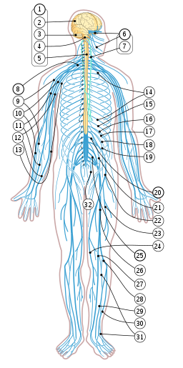
For example, Vagus Nerve (10th cranial nerve)
Innervates major body systems: heart, lungs, digestive track, immune system and social engagement system
Role: Calms and Restores both physical and psychological processes, Operative in ALL Social Behavior
Alfven, 2004; Calkins & Hill, 2007; Donzella et al., 2000; Jarrett et al., 2003; Propper et al 2008; Siniatchkin et al., 2003; Stam et al., 1997
https://commons.wikimedia.org/wiki/File%3ANervous_system_diagram_numbered.svg By This SVG image was created by Medium69. Cette image SVG a été créée par Medium69. Please credit this : William Crochot (Nervous system diagram.png) [CC BY-SA 4.0 (http://creativecommons.org/licenses/by-sa/4.0)], via Wikimedia Commons
EvolvedNest.Org

Slide 24
The Evolved Nest Provides Wellness Informed Care
9-Healing Practices
1-Soothing Perinatal Experiences
8-Nature Connection
2-On-Request
Breastfeeding
7-Responsive Relationships
Evolved
Nest
3-Positive, moving (no negative) touch
6-Allomothers
5-Self-Directed Social Play
4-Positive Climate
EvolvedNest.Org

Slide 25
8. Nature Connection
Daily Activities that calms, regulates and lowers cortisol
EcoAttachment.Dance
Walking outside
Sunning
Earthing
Gardening
Birdwatching
Hiking
Camping
Pay attention to the sunlight or clouds today.
Minimize harm to living things.
Practice gratitude for the sources of nourishment.
Acknowledge the other-than-humans you meet.
EvolvedNest.Org

Slide 26
The Evolved Nest Provides Wellness Informed Care
9-Healing Practices
1-Soothing Perinatal Experiences
8-Nature Connection
2-On-Request
Breastfeeding
7-Responsive Relationships
Evolved
Nest
3-Positive, moving (no negative) touch
6-Allomothers
5-Self-Directed Social Play
4-Positive Climate
EvolvedNest.Org

Slide 27
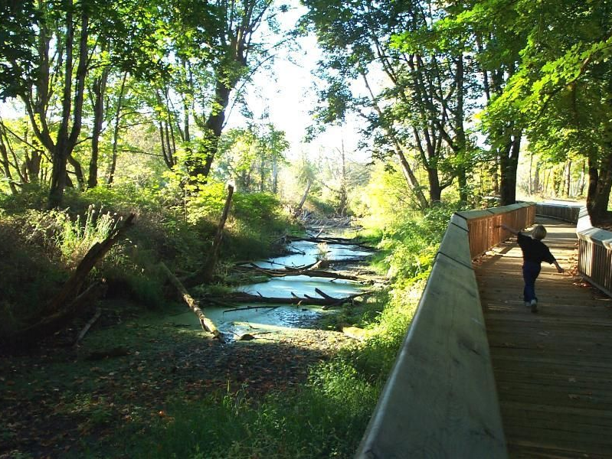
9. Healing Practices Routine practices to heal wounds
Singing
Meditation
Talking with friends
Physical stress (e.g., running, winter camping)
Helping others
EvolvedNest.Org

Slide 28
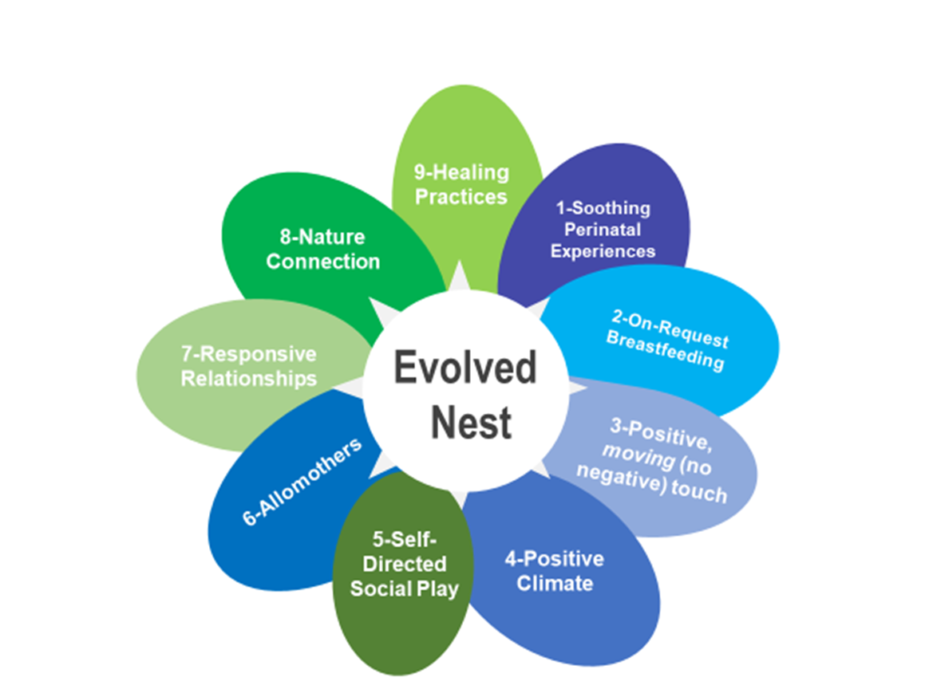
What happens with unnestedness?
Seeds ill health
Mental (anxiety, depression, anger, reactivity)
Physical
Social
Moral
Disconnection from self, others, community, world
EvolvedNest.org

Slide 29
What happens physiologically when infant needs are ignored?
Early Life Stress
undermines development
Stress response
Immune system
Endocrine system
Neurotransmitters (number, function)
Emotions and emotion systems
Corpus callosum and brain hemispheric integration
Gaps or lesions in brain systems from early trauma, abuse, neglect, or undercare
Narvaez, 2014

Slide 30
Early Life Stress and Inflammation
Immune system sensitive to childhood psychosocial stressors
Early life stress → alterations to autonomic, endocrine and immune systems
Lead to increase in inflammation in later life
Danese & Lewis, 2017, McEwen, 2019

Slide 31
What happens psychologically when early needs are ignored?
Distrust of own body
Impaired sense of self
Living AGAINST instead of WITH others
Socially disagreeable (oppositional or withdrawing)
Distrust of others -> anxiety, cynicism, demonization
Narvaez, 2014

Slide 32
Top-down
Shifting
In each social situation…
Conceptual Framing
Engagement (attunement)
Safety (defense)
“Safe”
“Unsafe”
Approach
Reward
Social Reading
Meaning- making
Mobilized: Fight-Flight
Immobilized: Freeze-Faint (hide)
Neuroception (safety or threat)
Bracing against life
Open to life
Bottom-up Shifting
Narvaez, 2014, based on Porges, 2011

Slide 33
Empirical Data from our Lab: Child and Adult

Slide 34
What Evolved Nest variables at 12 months predict Child Self-Control at 4 years of age? Tarsha, M.S., Kurth, A., Cheng, Y., Gleason, T., & Narvaez, D. (April, 2021). Predicting child self-regulation at 4 and 6 years by first year Evolved Developmental Niche experience. Society for Research in Child Development annual meeting.
1) 52 Variables that Measured EDN components at 12 months
2) Machine Learning Statistical Technique to investigate what variable most strongly related to child Inhibitory Self-Control 3 years later (Lasso-SEM using the R package RegSem, Jacobucci, 2020)
3) Results:
Breastfeeding
Touch behavior: negative; positive
Companionship parenting: sing
Observed maternal sensitivity
Alloparenting variables
4) We put these in a model to test of these EDN variables, which were the strongest predictors

Slide 35
Breastfeeding, Play and Alloparents at 12 months were the strongest predictors of Child Inhibitory Self-Control at 4 years of age
12 Month EDN Variables
4 Year Variables
Negative Touch
Internalized Conduct
Positive Touch
Inhibitory Control
Breastfeeding
Inhibitory Self-Control at 4 years
Companionship Caregiving (Sing)
Head/Toes
Play
Lab Gifts
Alloparents
Model is saturated.

Slide 36
How does Play influence child vagal tone in 6 year olds?
Measured amount of play in the last week (maternal report)
Assessed child vagal tone during three tasks: baseline, stress and recovery condition
Gleason, T., Tarsha, M. S., Woodbury, R., Kurth, A., Kaikhosroshvili, K., & Narvaez, D. (in press). Developmental Psychobiology

Slide 37
RSA Stress
Play and Vagal Tone
At 6 years of age, amount of play in the last week related to child vagal tone.
RSA Baseline
Tonic Vagal Tone
Play
Phasic Vagal Regulation
RSA Recovery
Baseline to Stress, χ² = 5.70, p = .34, CFI = .99, SRMR = .042; and Stress to Recovery, χ² = 5.42, p = .37, CFI = .99, SRMR = .061.

Slide 38
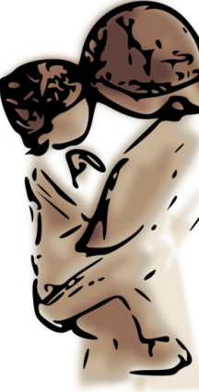
Evolved Nest Provision in past week
Participants: Parents (mostly mothers) of 3-5 year olds
(574 from USA; 96 from Switzerland, 382 from China)
TOUCH:
(a) Positive: How often did you affectionately touch, kiss, or hug the child?
(b) Negative: How often did you spank/hit/pinch/slap the child?
PLAY:
How much did the child play actively and freely with other children OUTSIDE (play organized by the children; not in organized activities)?
How much did the play actively and freely with other children INSIDE (play organized by the children; not in organized activities and not passive watching of television or videos)?
FAMILY TOGETHERNESS:
(a) How often did you do things together as a family AT HOME (e.g., eating together, doing chores together, playing)?
(b) How often did you do things together as a family OUTSIDE THE HOME (e.g., going to religious services, shows, community events, visiting parks, traveling)?

Slide 39
Normal sociomoral Development
Narvaez, D., Woodbury, R., Gleason, T., Kurth, A., Cheng, A., Wang, L., Deng, L., & Gutzwiller, E., Christen, M., & Naeflin, C. (2019).
Evolved Nest Provision: Moral Socialization, Social Maladaptation And Social Thriving in Three Countries. Sage Open

Slide 40
Parent Age
Empathy
e1
-.03
Parent Education
.73**
.02
Income
.10*
Internalized conduct
e2
.33**
Parental Responsivity
.42**
Moral Socialization
.56**
.55**
.24**
Inhibitory control
Child’s Gender
e3
.17**
.37**
.06**
EDNPR
Figure 1. USA Moral Socialization predicted by EDNPR and covariates. Standardized solutions. Robust χ2(23) = 28.92, p = .18; CFI = .99; RMSEA = .033, 90% CI RMESEA = [.00, .04]. * p < .05, ** p < .01
Concern after wrongdoing
e4

Slide 41
Poor Sociomoral Development
Narvaez, D., Woodbury, R., Gleason, T., Kurth, A., Cheng, A., Wang, L., Deng, L., & Gutzwiller, E., Christen, M., & Naeflin, C. (2019).
Evolved Nest Provision: Moral Socialization, Social Maladaptation And Social Thriving in Three Countries. Sage Open

Slide 42
Parent Age
Opposition
e1
-.06
.16**
.69**
Parent Education
.51**
Misbehavior
e2
-.05
.53**
.53**
Income
.04
Social Distrust
e3
Social Maladaptation
.70**
-.35**
Parental Responsivity
-.11*
.87**
.46**
-.08
Social Withdrawal
Child’s Gender
e4
.62**
EDNPR
-.11*
Anxiety
e5
.63**
Figure 2. USA Social Maladaptation predicted by EDNPR and covariates. Standardized solutions. Robust χ2(38) = 87.44, p < .001; CFI = .94; RMSEA = .05, 90% CI RMESEA = [.04, .06]. * p < .05, ** p < .01
.32**
Depression
e6

Slide 43
SOCIAL Developmental Optimization
Narvaez, D., Woodbury, R., Gleason, T., Kurth, A., Cheng, A., Wang, L., Deng, L., & Gutzwiller, E., Christen, M., & Naeflin, C. (2019).
Evolved Nest Provision: Moral Socialization, Social Maladaptation And Social Thriving in Three Countries. Sage Open

Slide 44
Parent Age
Social Attunement
e1
.01
Social Enjoyment
.45**
Parent Education
-.01
.85**
e2
Income
.09
.84**
Consideration
e3
.79**
Parental Responsivity
.45**
Sociality
.08**
.80**
Child’s Gender
.11**
Social Imagination
e4
.61**
EDNPR
.22**
.58**
Thriving
e5
Figure 3. USA Sociality predicted by EDNPR and covariates. Standardized solutions. Robust χ2(44) = 88.79, p < .001; CFI = .98; RMSEA = .05, 90% CI RMESEA = [.04, .06]. * p < .05, ** p < .01
.31**
Happiness
e6

Slide 45
Adult wellbeing sociality morality
Narvaez, D., Wang, L, & Cheng, A. (2016).
Evolved Developmental Niche History: Relation to adult psychopathology and morality.
Applied Developmental Science, 20(4), 294-309. http://dx.doi.org/10.1080/10888691.2015.1128835

Slide 46
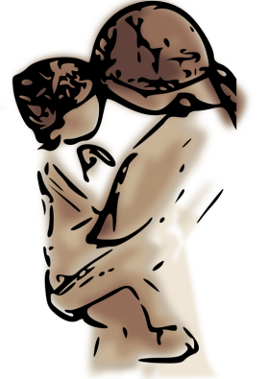
Adult data: Significant Mediation Patterns
Evolved Nest History
Attachment Security
Mental Health
Interpersonal Capacities
Ethical Orientation
607 USA adults
Relational attunement
vs.
Self-protection (withdrawal or opposition)
Perspective taking
vs.
Personal distress
Narvaez, Wang & Cheng, 2016, Applied Developmental Science

Slide 47
More Information
Dr. Darcia Narvaez
University of Notre Dame
Department of Psychology, dnarvaez@nd.edu
Lots on parenting and early life experience effects at Narvaez’s blog at Psychology Today: Moral Landscapes
http://www.psychologytoday.com/blog/moral-landscapes
Webpage (blog links, download apers, etc.) https://sites.nd.edu/darcianarvaez/
Watch BreakingTheCycleFilm.org
Find us at EvolvedNest.org
Mary Tarsha, M.Ed mtarsha@nd.edu

