Slide 1
Mothering as Manner, Content and Community Maternal Gift Economy Salon, May 22, 2021
The Evolved Nest
Darcia Narvaez, PhD, University of Notre Dame, EvolvedNest.org

Slide 2
Outline Today
1- Overview of Alternative Pathways (me)
2-Short Film
3- Evolved Nest Data (Mary Tarsha)

Slide 3
We Are Unwell
Human wellbeing in USA on the decline (even before the pandemic)
Mental illness, violence, drug addiction and suicide increasing
Shrinking lifespan
Folks under age 55 at a health disadvantage compared to 16 other advanced nations (NRC, 2013)
Child and adult wellbeing rank near bottom of advanced nations (OECD)
Humans are destroying their habitat (not all humans)
Earth systems are breaking down (IPBES, 2019)
Climate instability; melting of ice caps (IPCC)
Massive ecological disruption from human activity virtually everywhere (Millennial Eco Assessment)
Visible wildlife decreased by 50% in last 40 years (WWF, 2014)
Massive poisoning of soil, air, water, animal bodies
Oceans filling with plastic and decreasing animal life
EvolvedNest.Org

Slide 4
What have we forgotten about wellness?
What do sustainable societies have to teach us about wellness?
EvolvedNest.Org

Slide 5
Our wellness-informed pathway
Maternal Gift Economy
Meets humanity’s basic needs
Fosters thriving
Develops heart-mindedness
Supports earth-centered-living knowhow
EvolvedNest.Org

Slide 6
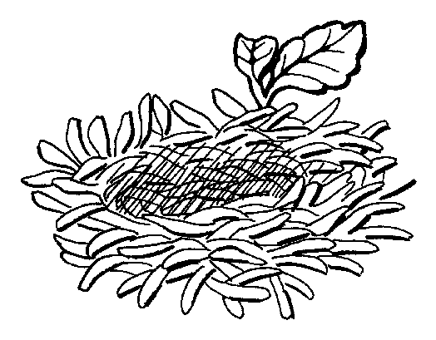
Our Heritage: Wellness-Informed Cycle of Cooperative Companionship
1 Companionship from conception
2 Good physio-neuro-social biology
3 Adult wellbeing and wisdom
4 Community attention to basic needs
What does it
look like?
EvolvedNest.Org

Slide 7
Insights from our 95%: Hunter-Gatherers on Child Raising
“Young children in foraging cultures are
nursed frequently;
held, touched, or kept near others almost constantly;
frequently cared for by individuals other than their mothers (fathers and grandmothers, in particular) though seldom by older siblings;
experience prompt responses to their fusses and cries;
and enjoy multiage play groups in early childhood.”
Hewlett & Lamb, 2005, p. 15
EvolvedNest.Org

Slide 8
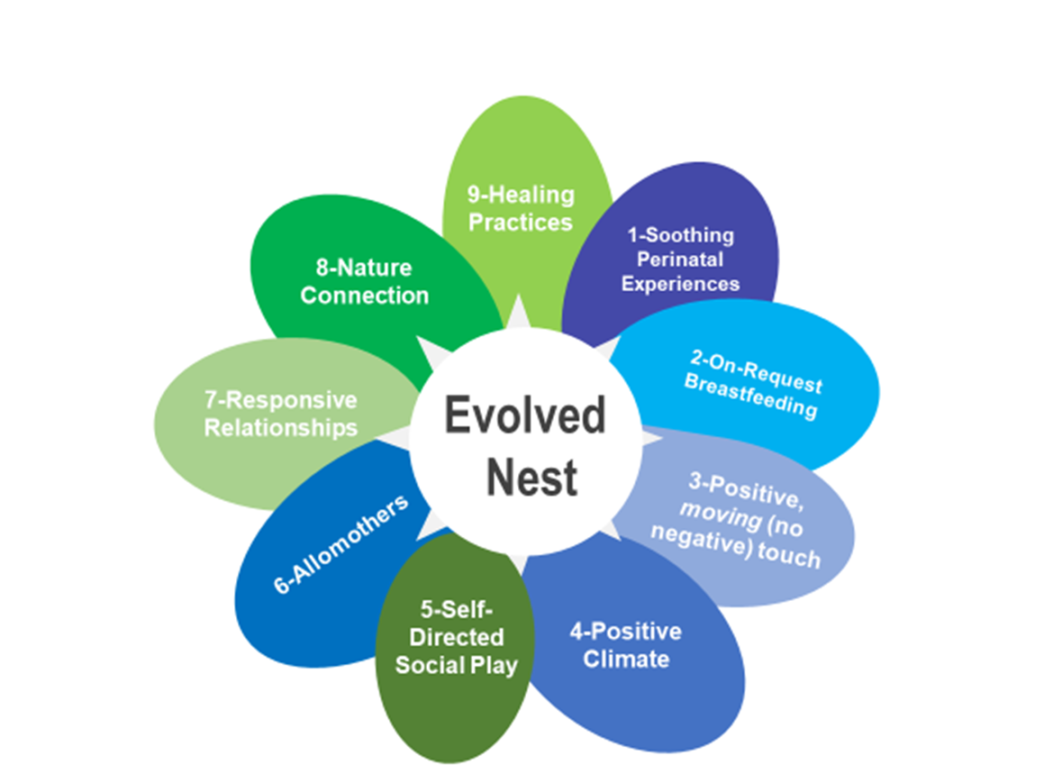
Humanity’s Evolved Developmental Niche (aka Evolved Nest)
One of many inheritances
The set of social and ecological circumstances typically inherited by members of a given species (Oyama et al. 2001)
Mostly over 75 million years old
Evolution has “done the experiments”
Human babies resemble fetuses till 18 months of age and, with rapid growth underway
So, their needs should be met quickly to foster a well-functioning brain.
EvolvedNest.Org

Slide 9
The Evolved Nest Provides Wellness Informed Care
9-Healing Practices
1-Soothing Perinatal Experiences
8-Nature Connection
2-On-Request
Breastfeeding
7-Responsive Relationships
Evolved
Nest
3-Positive, moving (no negative) touch
6-Allomothers
5-Self-Directed Social Play
4-Positive Climate
EvolvedNest.Org

Slide 10
The Four Worlds of Young Children (Stern, 1990)
Stories
Words
Mindscapes
Feelings
0-4 months
EvolvedNest.Org

Slide 11
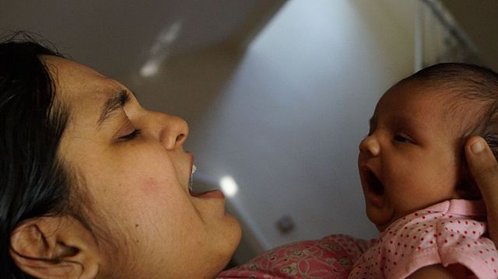
0-4 months: A World of Feelings
The baby experiences a human weatherscape, feelings-in-motion: “a sudden increase in interest; a rising, then falling wave of hunger pain; an ebbing of pleasure” (Stern, 1990, p. 14)
Shifting states of consciousness: sleep, drowsiness, alert inactivity, waking activity, irritability, distress crying
“The sensation of hunger [need] begins weakly but grows rapidly. While it is still weak and inconstant, [the baby] probably experiences it as a general irritability that interrupts the smooth functioning of his entire self. Everything is affected—his movements, breathing, attention, feeling, arousal, perceptions, and so on. This “global” interference must feel to [the baby] like a sudden disharmony in his world, a “something going wrong.” (p. 32). The baby becomes disorganized and the world appears disjointed and fractured.
Mother’s presence helps baby reconstitute himself after feeling “dissolved”
EvolvedNest.Org

Slide 12
The Evolved Nest Provides Wellness Informed Care
9-Healing Practices
1-Soothing Perinatal Experiences
8-Nature Connection
2-On-Request
Breastfeeding
7-Responsive Relationships
Evolved
Nest
3-Positive, moving (no negative) touch
6-Allomothers
5-Self-Directed Social Play
4-Positive Climate
EvolvedNest.Org

Slide 13
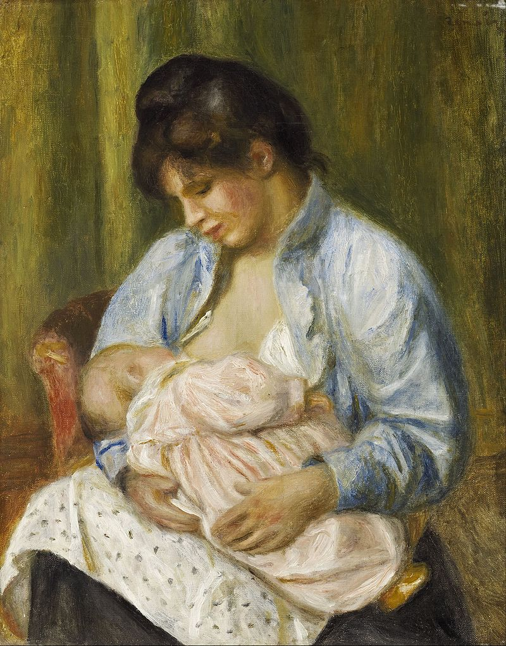
2. Breastfeeding empowers the child
The baby controls the size of each mouthful
The baby regulates how much he eats
The baby stops when he’s full
Breastmilk changes with the needs of the baby (sex, growth, antibodies)
Notes:
Transition: What’s the problem with bottles? Is there a problem with bottles?
Statements not questions

Slide 14
How long do mothers breastfeed?
Peaceful Societies
Plus carry young children in arms;
And no sanction of premarital sex (Prescott, 1996)
Ancestral
Context
See video comparing breastfeeding and infant formula
Notes:
Pictures to add: -some graphic (6 years- primate models/patterns, ancestors did it 4 years, WHO- 2 years, Academy of Pediatrics- 1 year)
-hunter gatherers 2-5 years on average, mode of 4
Graph whole page
Script (everything):
-Our ancestors breastfed on average for 6 years, until the first adult molar.
-The World Health Organization (WHO) recommends a minimum of 2 years of breastfeeding.
-Thus, it is normal to breastfeed the child for longer than a year.
-Breastmilk exclusively can satisfy the child for at least 12 months (?)
Why?
ADD PERCENTAGE

Slide 15
The Evolved Nest Provides Wellness Informed Care
9-Healing Practices
1-Soothing Perinatal Experiences
8-Nature Connection
2-On-Request
Breastfeeding
7-Responsive Relationships
Evolved
Nest
3-Positive, moving (no negative) touch
6-Allomothers
5-Self-Directed Social Play
4-Positive Climate
EvolvedNest.Org

Slide 16
3. Positive MOVING Touch and no negative touch
Insights on Child Raising from Hunter-Gatherers
Mostly constant touch in the first years of life
E. Richard Sorenson summarizing his experience with “preconquest” cultures:
Infants were kept in continuous bodily contact with mothers or the mothers’ friends—on laps when they were seated, on hips, under arms, against backs, or on shoulders when they were standing. Even during intensive food preparation, or when heavy loads were being moved, babies were not put down. They had priority. There was always a place for them against the body of a ‘mother’ or close associate. Loads could be shed or lightened, but babies were simply not put down, not deprived of constant, ever-ready, interactive body contact—even when the group was on the move under difficult conditions.
1998, pp. 83-84

Slide 17
The Evolved Nest Provides Wellness Informed Care
9-Healing Practices
1-Soothing Perinatal Experiences
8-Nature Connection
2-On-Request
Breastfeeding
7-Responsive Relationships
Evolved
Nest
3-Positive, moving (no negative) touch
6-Allomothers
5-Self-Directed Social Play
4-Positive Climate
EvolvedNest.Org

Slide 18
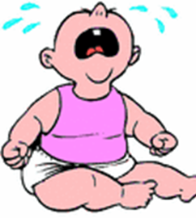
4. Positive Welcoming Social Climate Does NOT Include Letting Babies Cry
“According to popular belief, crying should decrease through maternal failure to respond contingently to it…There is no evidence of an extinction process in our sample of home-reared infants.
“Our data suggest the contrary—that those infants who are conspicuous for fussing and crying after the first few months of life, and who fit the stereotype of the "spoiled child," are those whose mothers have ignored their cries or have delayed long in responding to them.
The difficult infants were those with
insensitive, unresponsive, controlling mothers;
Mothers who tried to mold babies to their routines, wishes, and expectations.
Bell, S.M., & Ainsworth, M.D. (1972). Infant crying and maternal responsiveness. Child Development 43, 1171-1190.

Slide 19
The Positive Climate
“A responsive mother, our data suggest, not only provides the conditions that terminate a cry, thus reducing its duration, but also is likely to provide conditions that tend to prevent crying from being activated or reactivated.
“Those babies who, by the end of the first year, have well-developed channels of communication tend to be the same who cry little, and, as has been shown previously, these are the ones whose cries were promptly heeded throughout the first year of life.
Maternal responsiveness to infant signals develops communication skills.
Bell, S.M., & Ainsworth, M.D. (1972). Infant crying and maternal responsiveness. Child Development 43, 1171-1190.
“Thus, infants whose mothers are responsive to their signals have less occasion to cry—not only in the first few months but throughout infancy.

Slide 20
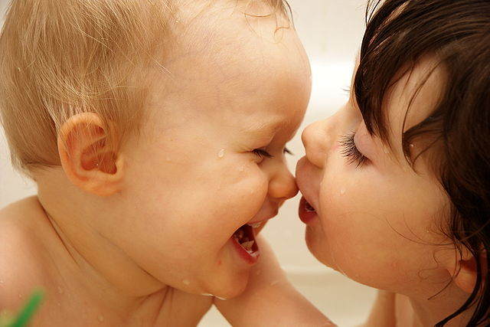
How to Be Welcoming: Infant-Elicited Social Behaviors
FACIAL EXPRESSIONS (e.g., mock surprise: eyes widen, eyebrows up, mouth open, head up—which signal a readiness to interact)
VOCALIZATION (baby talk; repetition; wide range of pitch with emphasis on high pitch; fewer words, simple syntax)
GAZE (reverses adult style of listener gazes-speaker not; can be locked in gaze for 30 seconds or longer)—which evokes arousal and feelings
HEAD MOVEMENTS (e.g., peek a boo)
PROXEMICS (although babies don’t like looming objects, the mother moves in perhaps to train the child to tolerate intimate proxemics)
Movements exaggerated in space and time.
A limited set of expressions are performed frequently.
Dan Stern, 1979; 2010

Slide 21
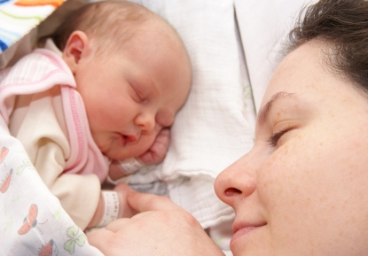
Well-functioning adult personalities depend on welcoming childhoods
Well-adapted personalities show a smoothly working balance of, on the one hand, initiative and self-reliance, and, on the other, a capacity both to seek help and to make use of help when occasion demands.
An examination of their development shows that they have grown up in closely knit families with parents who, it seems, have never failed to provide them with support and encouragement.
Though here evidence is less substantial, the family itself has been and still is part of a stable social network within which a growing child is welcome and can mix both with other adults and with peers, many of whom are familiar to him from his earliest years.
John Bowlby (1979). The Making and Breaking of Affectional Bonds. London: Tavistock.

Slide 22
The Evolved Nest Provides Wellness Informed Care
9-Healing Practices
1-Soothing Perinatal Experiences
8-Nature Connection
2-On-Request
Breastfeeding
7-Responsive Relationships
Evolved
Nest
3-Positive, moving (no negative) touch
6-Allomothers
5-Self-Directed Social Play
4-Positive Climate
EvolvedNest.Org

Slide 23
5. Self-Directed Play: Play in First Year
Social play begins at 6 weeks, when baby can hold gaze.
The immediate goal of a face-to-face play interaction is to have fun, to interest and delight and be with one another.
Both partners must regulate the quality, quantity, and timing of stimulus events so that attention, excitement, and affect can rise and fall, each within its own optimal range.
“We have learned that the purely social interactions, sometimes called “free play,” between mother and infant are among the most crucial experiences in the infant’s first phase of learning and participating in human events. By the end of the first six months the work of this phase is done, and it is considerable.”
What does the baby learn?
Schemas of the human face, voice and touch generally
and also specifically of the caregiver
Temporal patterning of human behavior
Meanings of different changes in tempo and rhythm
Conventions for initiating, maintaining, terminating & avoiding interactions.
Turn taking
Reading the signals and expressions of others
From Dan Stern, The First Relationship: Infant and Mother, 1979

Slide 24
The Evolved Nest Provides Wellness Informed Care
9-Healing Practices
1-Soothing Perinatal Experiences
8-Nature Connection
2-On-Request
Breastfeeding
7-Responsive Relationships
Evolved
Nest
3-Positive, moving (no negative) touch
6-Allomothers
5-Self-Directed Social Play
4-Positive Climate
EvolvedNest.Org

Slide 25
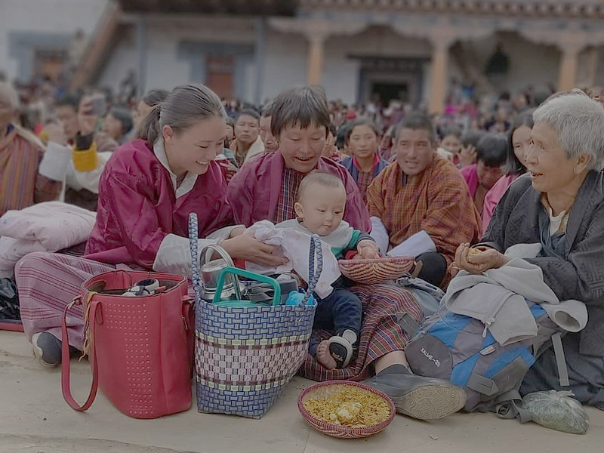
6. Allomothers (Other Nurturers)
Mothers need support to care well for their children (Hrdy, 2009)
Mother’s perceived social support:
Correlated positively with children’s social skills and negatively
with behavior problems (e.g., Achenbach, 1974; Koverola et al., 2005).
“Children do best in societies where childrearing is considered too important to be left entirely to parents.” (S. Coontz, 1992)
EvolvedNest.Org

Slide 26
Mothering is a Joint Activity
Mothers evolved to be nested in layers of support.
Loving nurturance
Mentoring
Shared caring and provisioning of children

Slide 27
The Evolved Nest Provides Wellness Informed Care
9-Healing Practices
1-Soothing Perinatal Experiences
8-Nature Connection
2-On-Request
Breastfeeding
7-Responsive Relationships
Evolved
Nest
3-Positive, moving (no negative) touch
6-Allomothers
5-Self-Directed Social Play
4-Positive Climate
EvolvedNest.Org

Slide 28
7. Responsive Relationships
Reciprocal communication
Synchrony and repaired dysynchrony
Mutual influence
Building of shared narratives
Meeting child’s needs in the moment
Mutual co-regulation
EvolvedNest.Org

Slide 29
The Importance of Caregiver Attunement
“Secure attachment thus depends on the mother’s psychobiological attunement not with the infant’s cognition or behavior, but rather with the infant’s dynamic alterations of autonomic arousal, the energetic dimension of the child’s affective state.
To enter into this rapid communication, the mother must resonate with the dynamic crescendos and decrescendos of the infant’s bodily-based internal states of peripheral autonomic nervous system (ANS) arousal and central nervous system (CNS) arousal.
This autonomic activity occurs at an unconscious level. …the psychobiologically attuned mother of the securely attached child not only minimizes the infant’s negative states in comforting transactions but also maximizes his or her positive affective states in interactive play.
Regulated and synchronized affective interactions with familiar, predictable primary caregiver create not only a sense of safety but also a positively charged curiosity, wonder, and surprise that fuels the burgeoning self’s exploration of novel socioemotional and physical environments. This ability is a marker of adaptive infant mental health.”
Allan Schore, 2019, p. 10

Slide 30
OVERAROUSED: Discomfort, Panic, Fear, Anger
RESPONSIVE
Caregiving
SWEET SPOT: Optimal arousal for healthy growth
UNDERAROUSED: Dysregulation of heart rate, breathing, digestion

Slide 31
The Evolved Nest Provides Wellness Informed Care
9-Healing Practices
1-Soothing Perinatal Experiences
8-Nature Connection
2-On-Request
Breastfeeding
7-Responsive Relationships
Evolved
Nest
3-Positive, moving (no negative) touch
6-Allomothers
5-Self-Directed Social Play
4-Positive Climate
EvolvedNest.Org

Slide 32
8. Nature Connection
Our heritage is to follow cycles
Women’s cycles follow moon cycles
Birth-Life-Death-Transformation
Seasons
Place-based knowhow

Slide 33
Sustainable Indigenous Nature Connection
A thing is right when it tends to preserve the integrity, stability, and beauty of the biotic community. It is wrong when it tends otherwise.
--Aldo Leopold,
A Sand County Almanac

Slide 34
Today
“Nature Deficit Disorder” (Louv, 2005)
Nature disconnection so we are not caring properly for the earth (W. Berry, 2013)

Slide 35
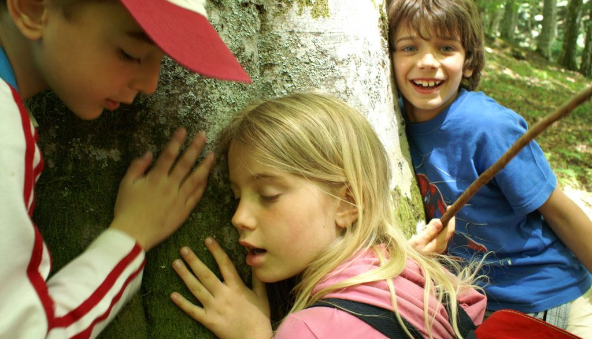
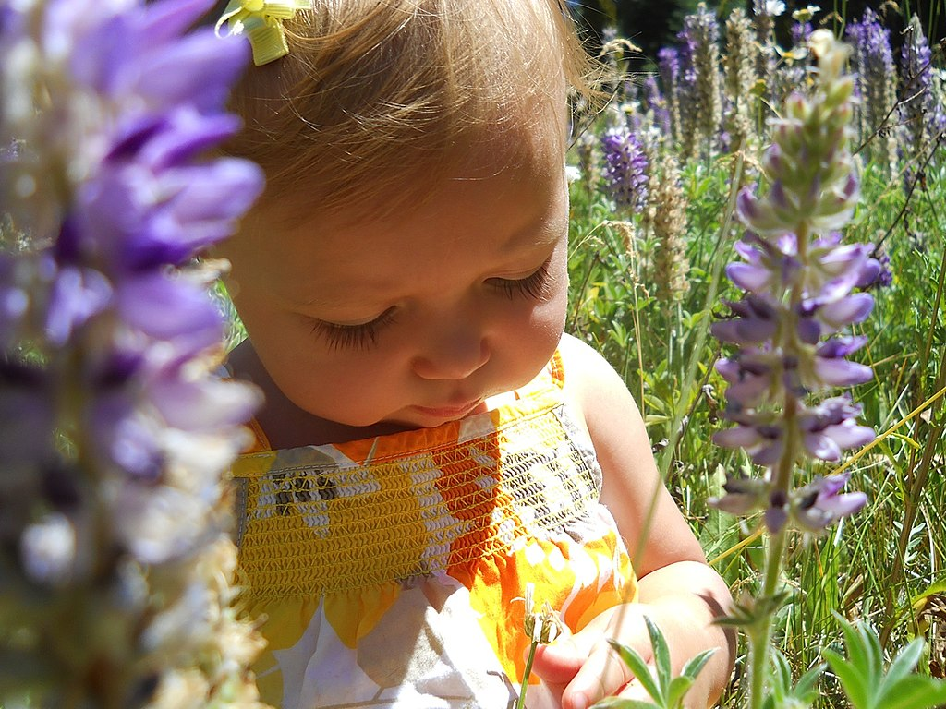
Nature Immersion
Fosters
Attachment to and responsibility for natural landscape
Caring relationships with the natural world of plants, animals and other entities
Respect for the created world (Medin & Bang, 2014)

Slide 36
The Evolved Nest Provides Wellness Informed Care
9-Healing Practices
1-Soothing Perinatal Experiences
8-Nature Connection
2-On-Request
Breastfeeding
7-Responsive Relationships
Evolved
Nest
3-Positive, moving (no negative) touch
6-Allomothers
5-Self-Directed Social Play
4-Positive Climate
EvolvedNest.Org

Slide 37
Healing Ceremonies (Community) To promote respect for Nature, community bonding, heal relationships
Shifting power
Community rituals: rhythmic trance dancing, shamanic healing,

Slide 38
The Wellness-Informed Cycle of Cooperative Companionship
1 Companionship from conception
2 Good physio-neuro-social biology
3 Adult wellbeing and wisdom
4 Community attention to basic needs
EvolvedNest.Org

Slide 39
What is The Other Pathway?
Trauma-Inducing

Slide 40
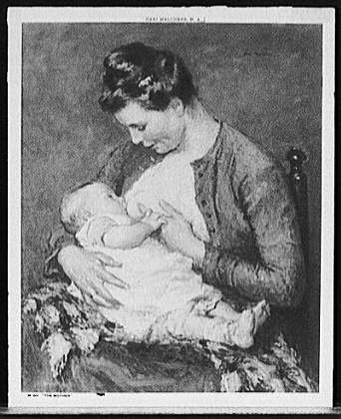
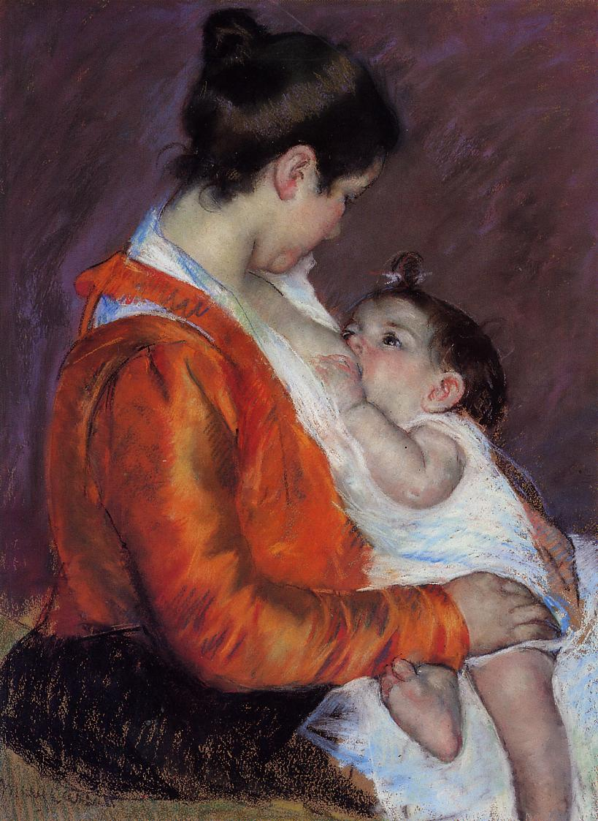
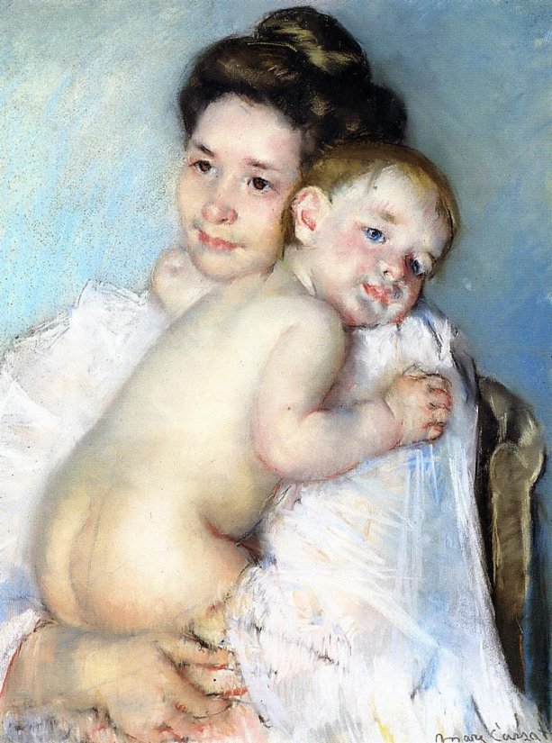
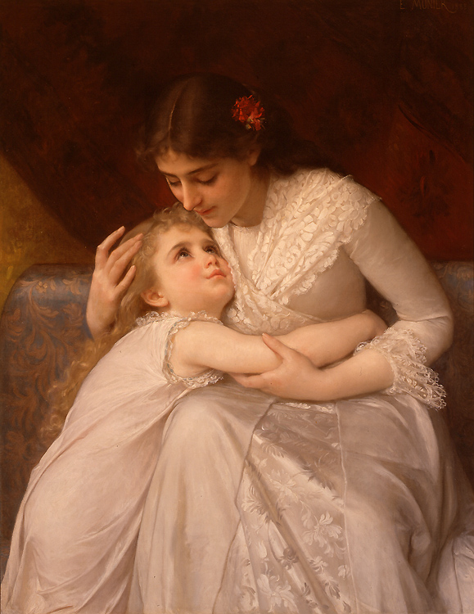
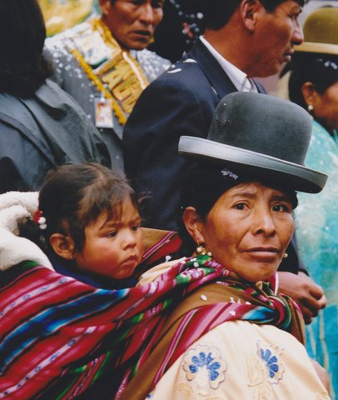
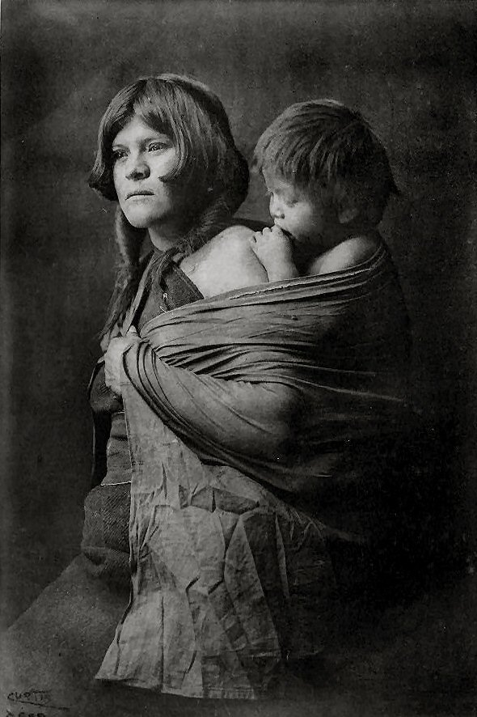
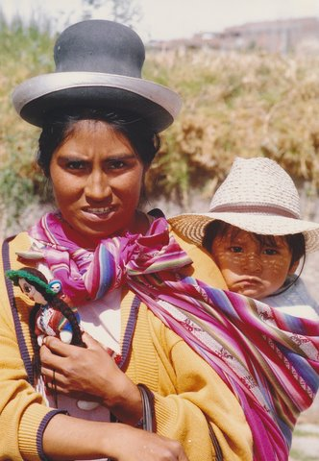
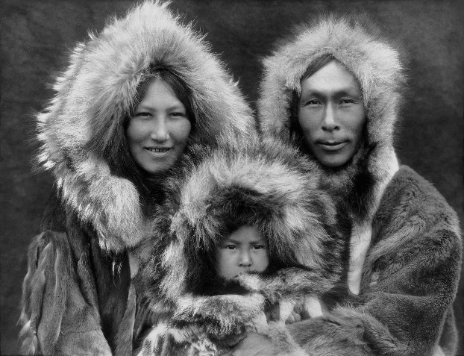
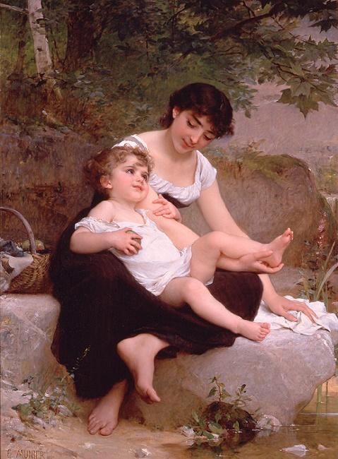
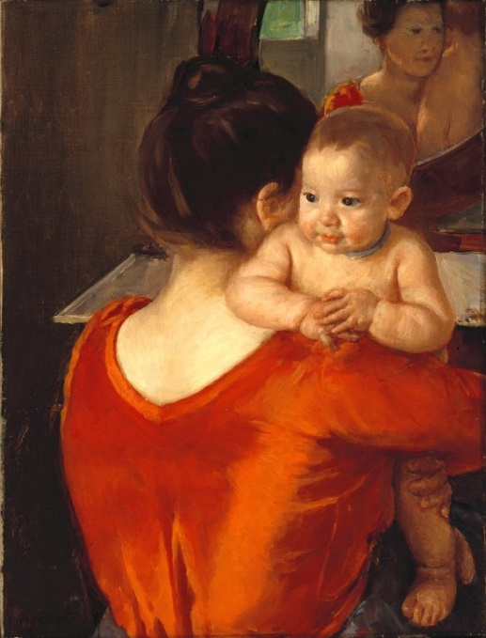
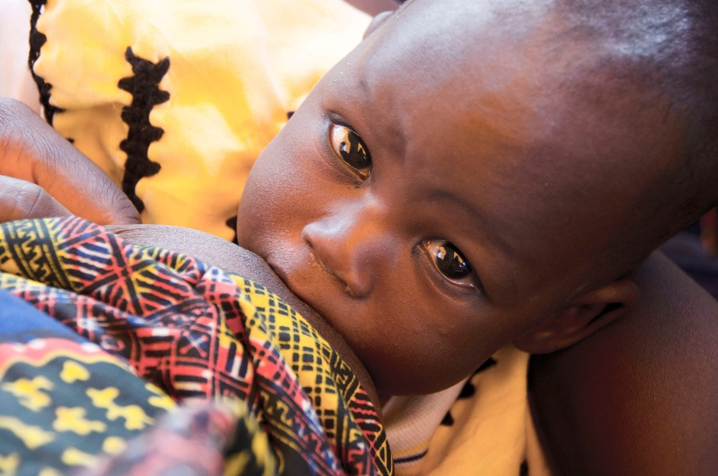
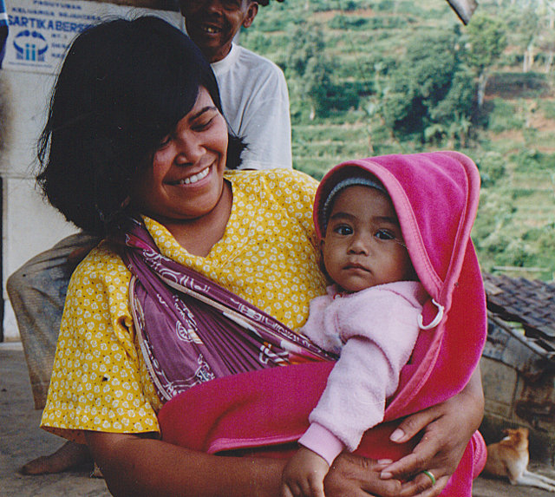
Peter van der Sluijs [CC BY-SA 3.0 (https://creativecommons.org/licenses/by-sa/3.0)] Peter van der Sluijs [CC BY-SA 3.0 (https://creativecommons.org/licenses/by-sa/3.0)] Peter van der Sluijs [CC BY-SA 3.0 (https://creativecommons.org/licenses/by-sa/3.0)] Black and White: Edward Sheriff Curtis (1868-1952) was an American photographer. Many of his works are held by the U.S. Library of Congress; these are all now part of the public domain, since their copyright was never renewed. Older paintings by Emile Manier, public domain; newer style paintings by Mary Cassatt, public domain. The Virgin and Child under an Apple by Lucas Cranach the Elder , public domain c[between 1900 and 1920] Melchers, Gari, 1860-1932, artist [Public domain] USAID public domain

Slide 41
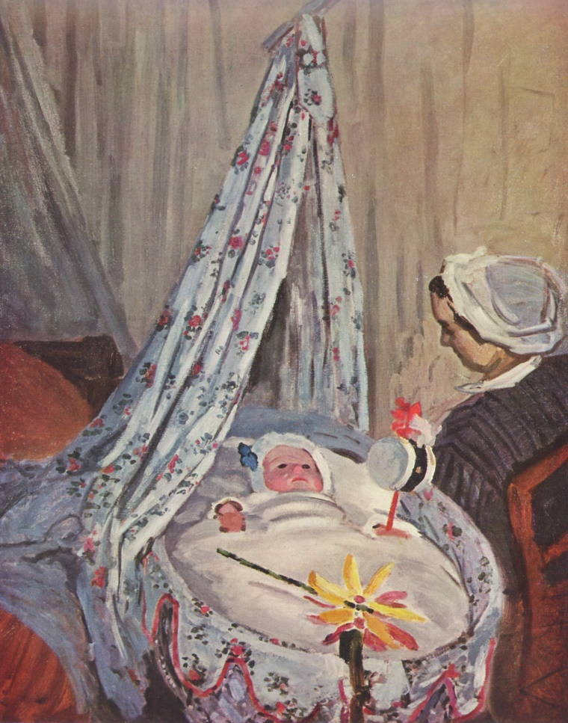
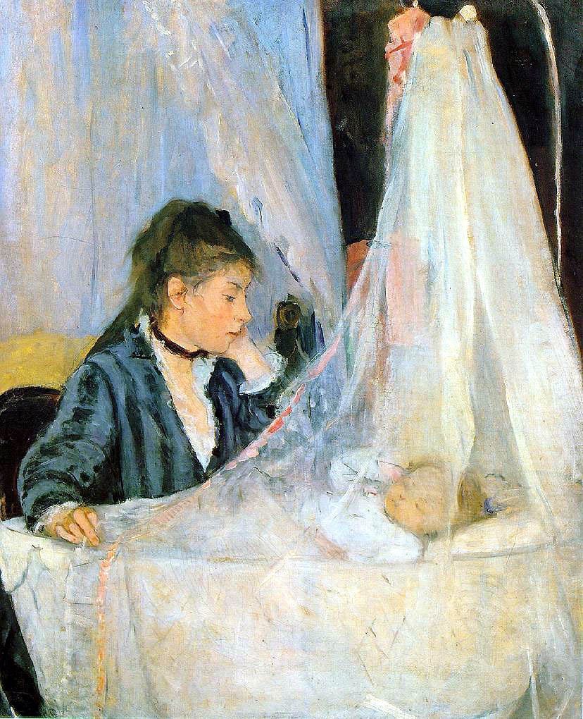
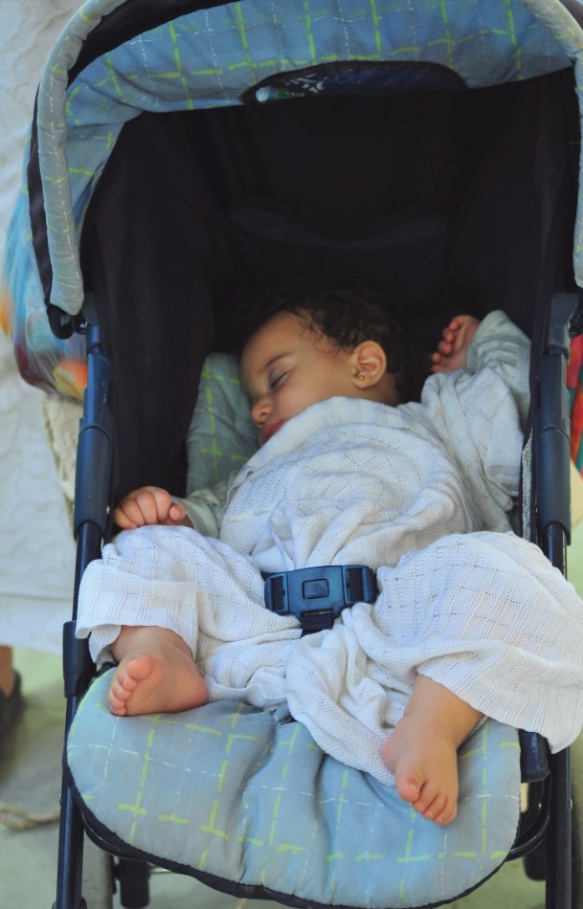
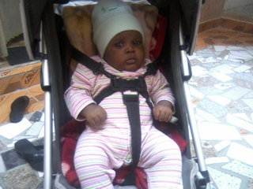
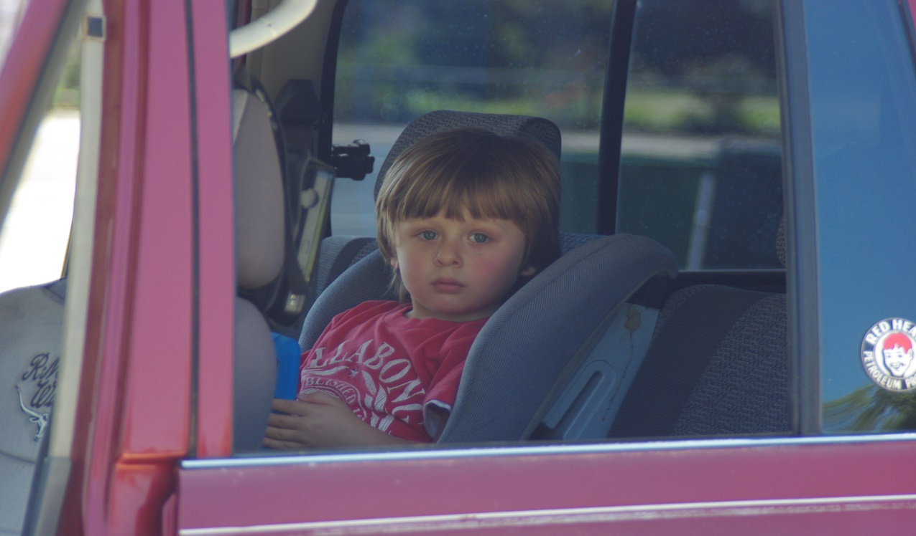
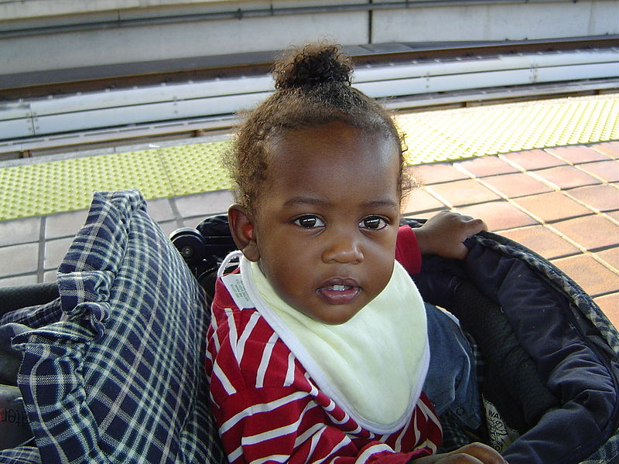
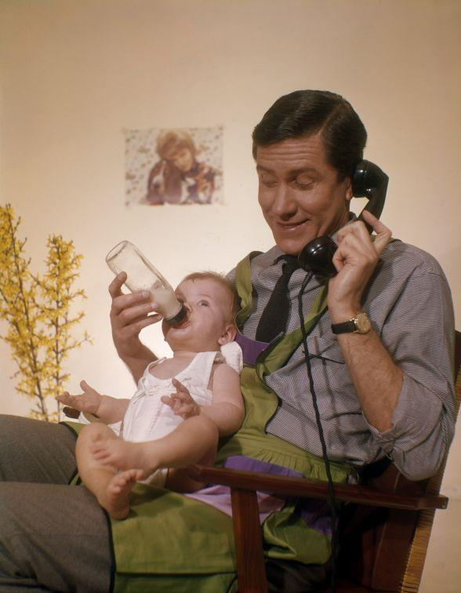
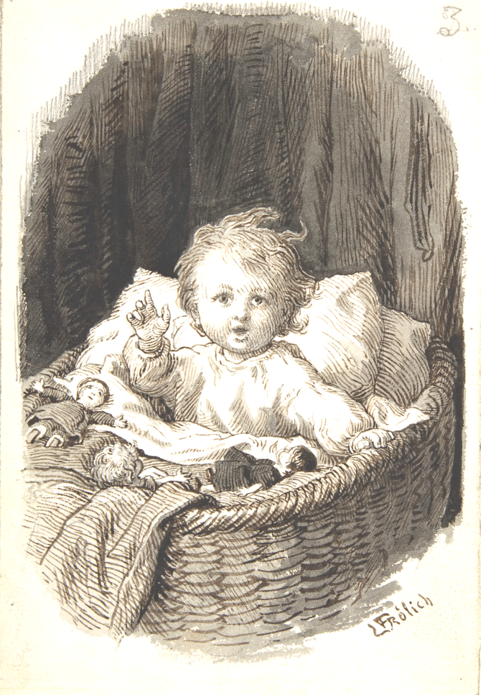
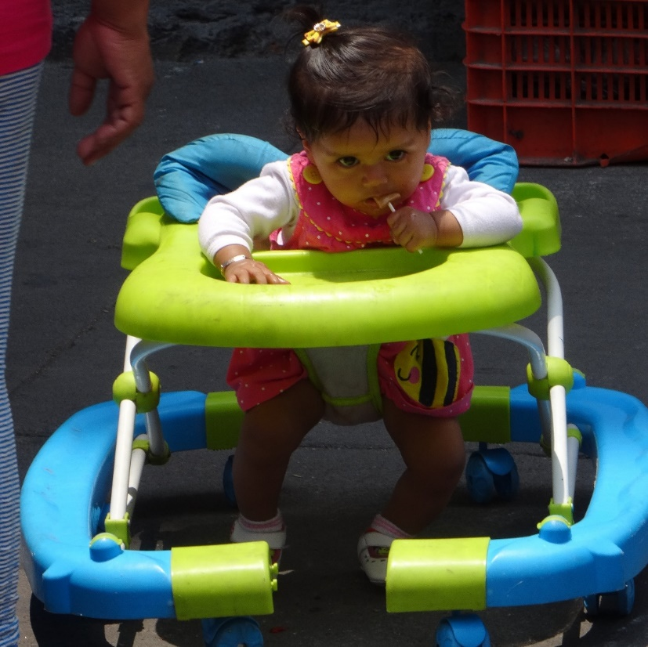
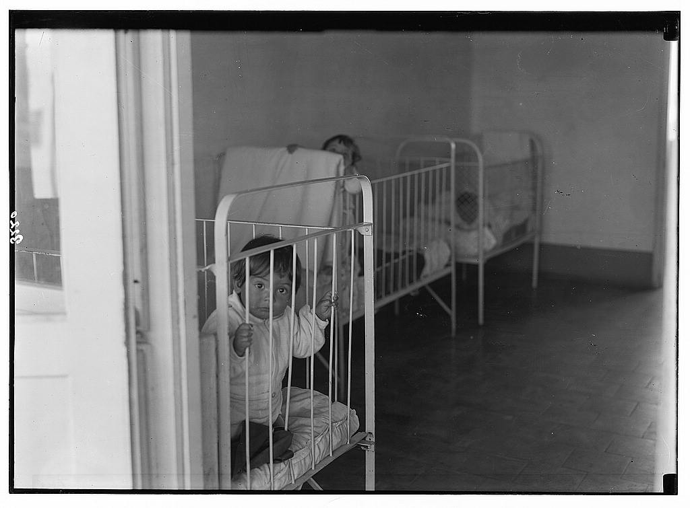
participant in Wikipedia Takes Waroona, photo scavenger hunt. Participants in these events have agreed to have their photos uploaded under free licenses by the event organizers. 5: Marabou child sitting in a stroller. Author =Rainmaker7469; This file is made available under the Creative Commons CC0 1.0 Universal Public Domain Dedication.
By Matson Collection [Public domain or Public domain], via Wikimedia Commons
By Fadi El Binni of Al Jazeera English [CC BY-SA 2.0 (https://creativecommons.org/licenses/by-sa/2.0)], via Wikimedia Commons
By Shamsurabiu [CC BY-SA 3.0 (https://creativecommons.org/licenses/by-sa/3.0)], from Wikimedia Commons
By Adam Jones from Kelowna, BC, Canada [CC BY-SA 2.0 (https://creativecommons.org/licenses/by-sa/2.0)], via Wikimedia Commons
Nationaal Archief [No restrictions]

Slide 42
What happens when mothering, nestedness, is degraded?
Evolved expected support NOT provided
Species-Atypical Developmental System
Outside evolved range of intelligence & effectiveness
Species Atypical Outcome
Narvaez, 2014

Slide 43
Cycle of Competitive Detachment
4 DEGRADED CULTURE
Adults distracted, overwhelmed, neglectful or overcontrolling
1 UNDERCARE
Developmentally inappropriate childrearing
3 ADULT illbeing & limited socio-moral capacities
2 POOR DEVELOPMENT of psychosocial neurobiology
Narvaez, 2014

Slide 44
Shift to Patriarchy and Hierarchy
Degraded Nest and Undermining of human development

Slide 45
II. We forgot our fullest capacities

Slide 46
What Human Thriving Looks Like
THRIVING INDIVIDUAL
A Quiet Mind.
Inner Happiness. Childlike glee.
Vitality.
Being Fully Alive.
Autonomy.
Honesty.
Sense of humor.
Outstanding memory and senses.
Builds habits at will.
Knowhow for getting along in the particular landscape.
Ecological attachment. Relational respect for nature.
Connection to Spirit. Has awareness of reality beyond the manifest.
THRIVING IN RELATIONSHIP
Enjoys being with others and enhances their being
Relationally attuned and responsive
Empathy given and received.
Unconditional Listening.
Communal orientation.
Authentic Helpfulness.
Unconditional Love and Forgiveness.
Generosity. Sharing practiced and expected.
Egalitarian. No one coerces anyone else.
Respect for ancestors and future generations.
Responsibility toward the web of life.
J. Young; Sorenson; Lee; Narvaez

Slide 47
Polysemy: Dynamic, Shifting Flow State
Dominant in original societies
Multiperspectivalism
Ability to perceive entities from multiple changing perspectives, depending on the context and mood.
Transpersonalism
Ability to merge with multiple others, human and non-human.
Result of de-differentiation
Finding oneness with others rather than difference and separation.
Fullness of Now:
Focus on present moment, heavy with connection to others, including the other-than-human, to ancestors and other spiritual aspects of a dynamic, fluctuating universe.
Right Brain Dominance
Marvin Bram

Slide 48
Univocity: Problem Solving Thinking
Dominant in hierarchical societies
Linear logical thinking, assessing past and predicting future
Relies on differentiation (something is or isn’t).
Reality is one thing only, not pluralistic
Reality is hierarchical
Obsession with order, precision and prediction
Hierarchically-arranged societies made up of separate bits
People, offices, assembly lines, or power structures.
Contests determine the few who are at the top of the pyramid.
Differentiation leads to deep anxiety and death terror
the sense of the present is thin and emptied out of polysemy.
The focus is on the future which will bring about certain death.
Left Brain Dominance
Marvin Bram

Slide 49
Reshaping of Mind (& Suppression of Heart) through Western History, increasing…
Self-protectionist thought, action, worldview
Suppression of polysemy; emphasis on univocity
Sense of disconnection
Dishonoring nature and the cycle of life
Coercion instead of nurturing taken as normal
Human potential not reached
Degraded
Evolved Nest
Narvaez, 2014

Slide 50
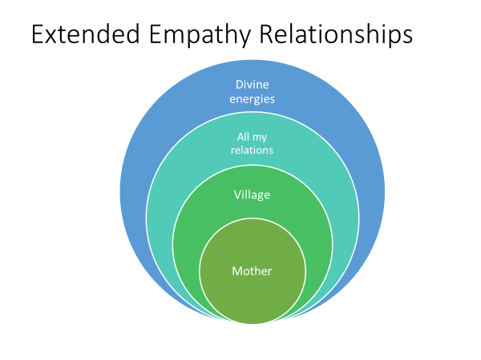
Signals of Poor Holistic Empathy
Political-economic
The parasitism of the wealthy
Unfettered capitalism
Environmental toxicity propelled by corporations and culture
Planetary
Global warming and climate instability
Devastation of biocultural diversity
Applied Culture
White Euro supremacism
Undercare and traumatization of children
Human capacities diminished
Ill being
Self-protectionist ethics
Wetiko
People
like me

Slide 51
Contrasting Worldviews
“Unified, sacred and moral cosmos”
Vs.
“Fragmented, disenchanted, amoral cosmos”
Robert Redfield, The Primitive World and its Transformation
Four Arrows, Point of Departure (2016); Four Arrows & D. Narvaez , “Reclaiming our Indigenous Worldview” (2016)
Only humans have spirit
Only humans matter
Humans are the pinnacle
CHARACTERISTICS
Restlessness (“homeless”)
Conforming landscapes to abstract ideals
Hoarding
Spirit pervades all things
Mutual relatedness with All
Humans are the younger siblings
CHARACTERISTICS
Placefulness (at home)
Fitting in with local landscape & biocommunity
Reciprocal sharing
DOMINANT CULTURE
from 17th century
INDIGENOUS
(our baseline)

Slide 52
Ethical versus Unethical Treatment of Babies
Ethical: Provide what baby needs
Unethical: Deny what baby needs

Slide 53
Outline Today
1- Overview of Alternative Pathways (me)
2-Short Film
3- Evolved Nest Data (Mary Tarsha)

Slide 54
1 Companionship caregiving
2 Good physio-neuro-social biology
3 Adult wellbeing and wisdom
4 Community attention to basic needs
EvolvedNest.Org

Slide 56
For healing ask: What did your community forget?
Should accompany the question:
What happened to you?

Slide 57
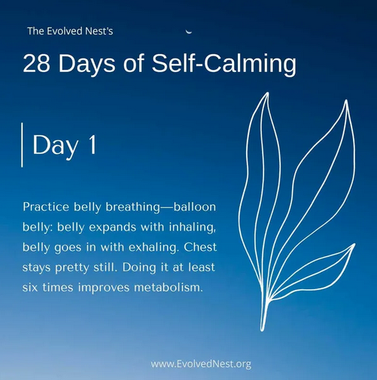
Click on image to go to website

Slide 58
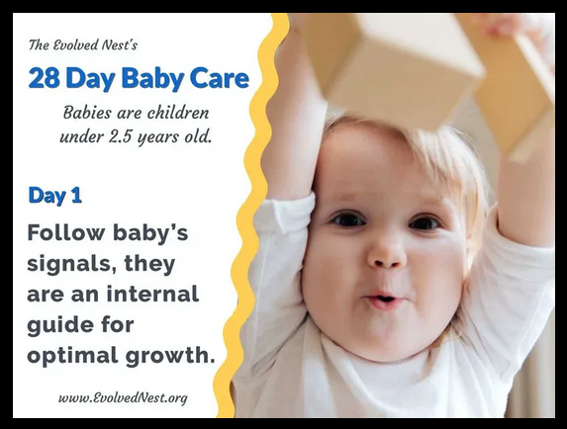
Click on image to go to website

Slide 59
Click on the image to go to the website
28 Days of Nature Connection

Slide 60
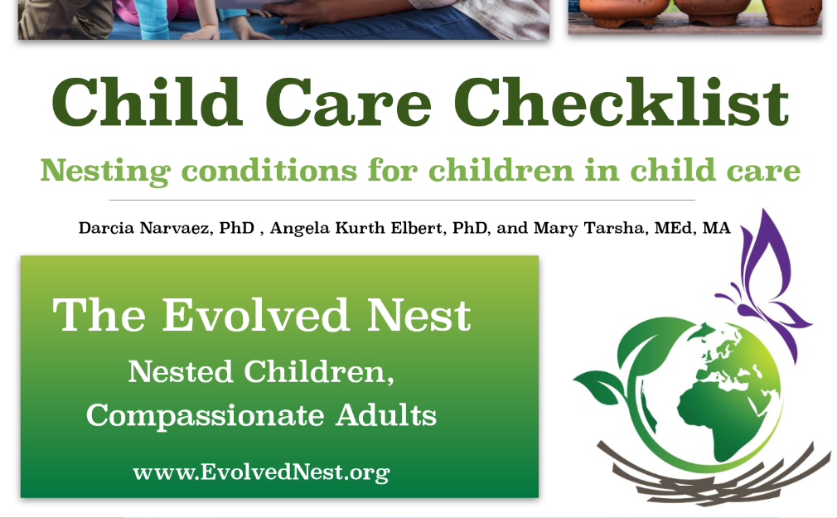
Click on the image to go to the website

Slide 61
Click on the image to go to the website

Slide 62
Wellness-Informed: The Evolved Nest Supports Wellbeing
Evolved
Nest
Physical Health
Mental Health
Self-control
Intelligence
Sociality
Cooperation
EvolvedNest.Org

Slide 63
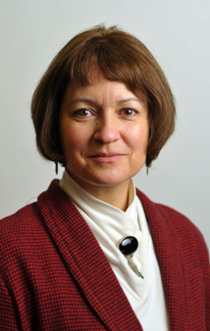
More Information
Dr. Darcia Narvaez
University of Notre Dame
Department of Psychology, dnarvaez@nd.edu
Lots on parenting and early life experience effects at Narvaez’s blog at Psychology Today: Moral Landscapes
http://www.psychologytoday.com/blog/moral-landscapes
Webpage (blog links, download apers, etc.) https://sites.nd.edu/darcianarvaez/
Watch BreakingTheCycleFilm.org
Find us at EvolvedNest.org
Mary Tarsha, M.Ed mtarsha@nd.edu

