Slide 1
Two Spirits:
Fractals of the Twinned Cosmos
Barbara Alice Mann
August 14, 2021

Slide 2
Fractals: A Primer
Definition
A Never-Ending Pattern
Irregular
Repeated Endlessly but Identifiably in
Nature
Geometry
Algebra

Slide 3
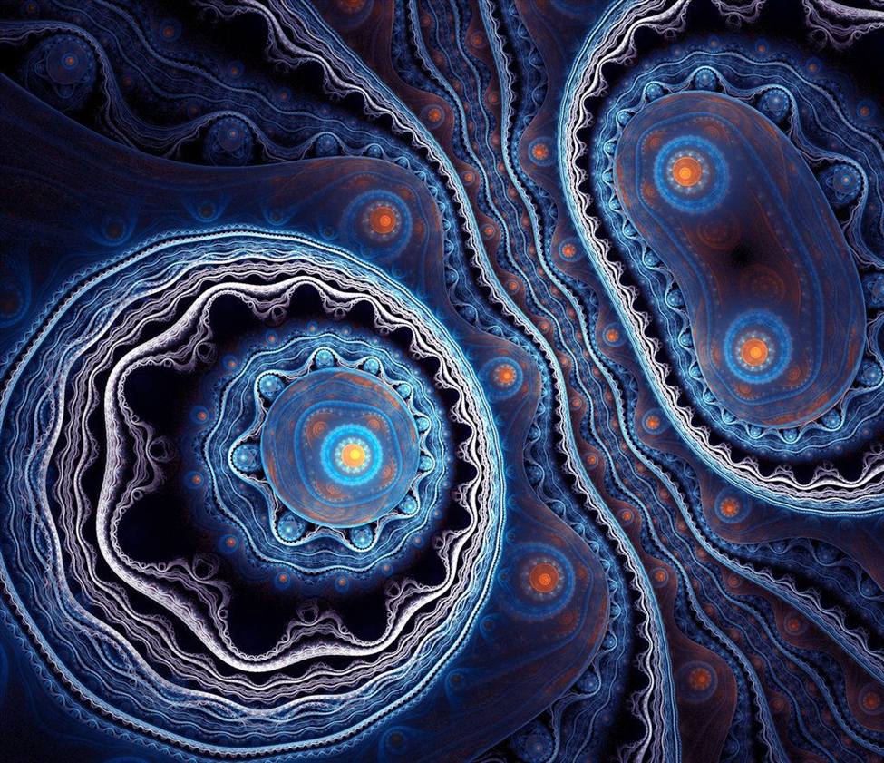
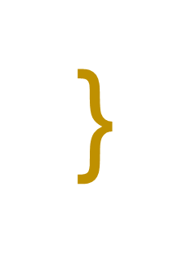
The Twinned Cosmos: Dual Fractals
Fractal #2: Breath
Fractal #1: Blood
Outer Space
Blood
Water
Earth
(Name)
Breath
Air
Sky
}
N
A
M
E
Fractal #1
Fractal #2
Planet
Earth

Slide 4
As Complements
Not Western-Defined
The Binary as
Twinship Completion
Not Opposing Competition
Continental-Wide Iconography

Slide 5
North America: Sacred Twinship Serpent & Eagle Mound Motifs
Great Horned Serpent Mound
Adams County, Ohio
Rock Eagle Mound
Eatonville, Georgia

Slide 6
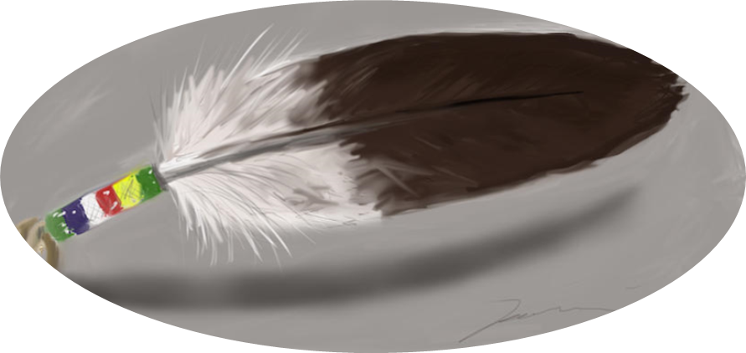
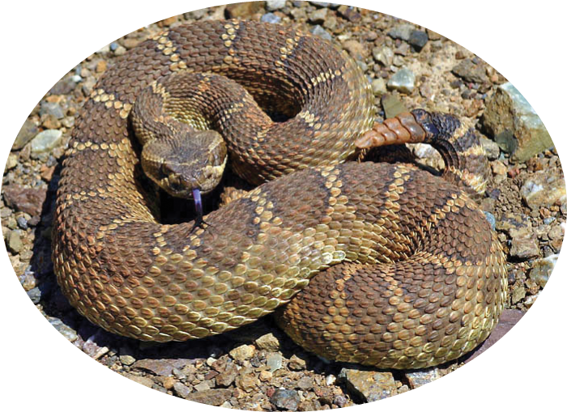
Central America: Quetzecoatl: The Feathered Serpent
As Combo
Earth (Snakes)
Breath (Feathers)

Slide 7
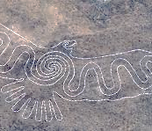
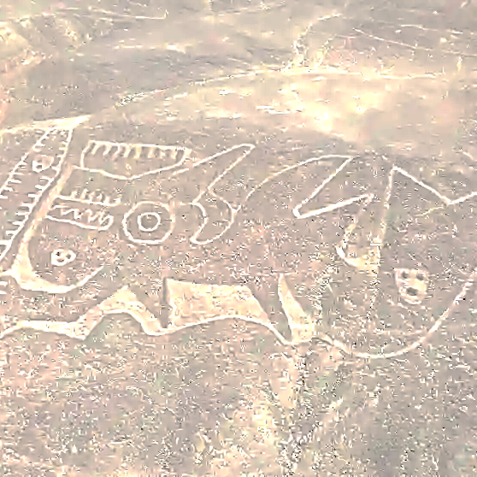
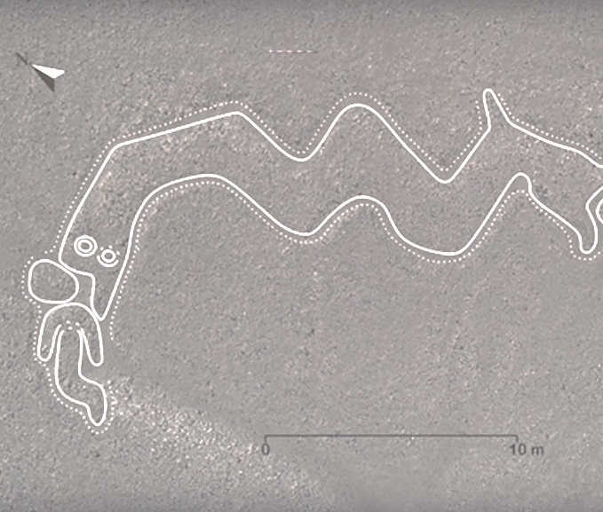
South America
Blood as
Whales
Fish
Serpent
Serpent Design on Eagle (i.e., Combo)
Nazca Lines

Slide 8
South America
Large Cats as Breath Counterpart
Just Discovered
Nazca Etching of Large Feline
2,000 Years Old

Slide 9
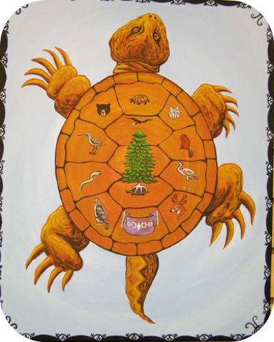
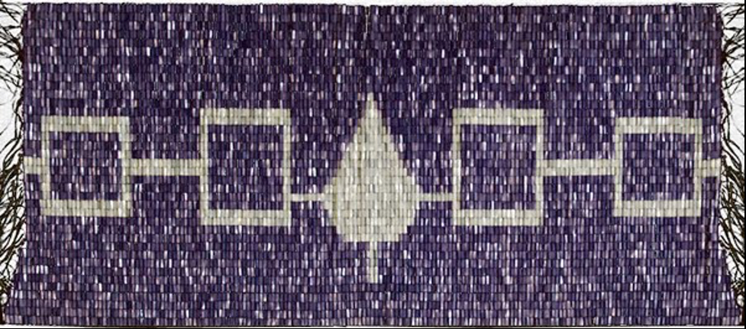
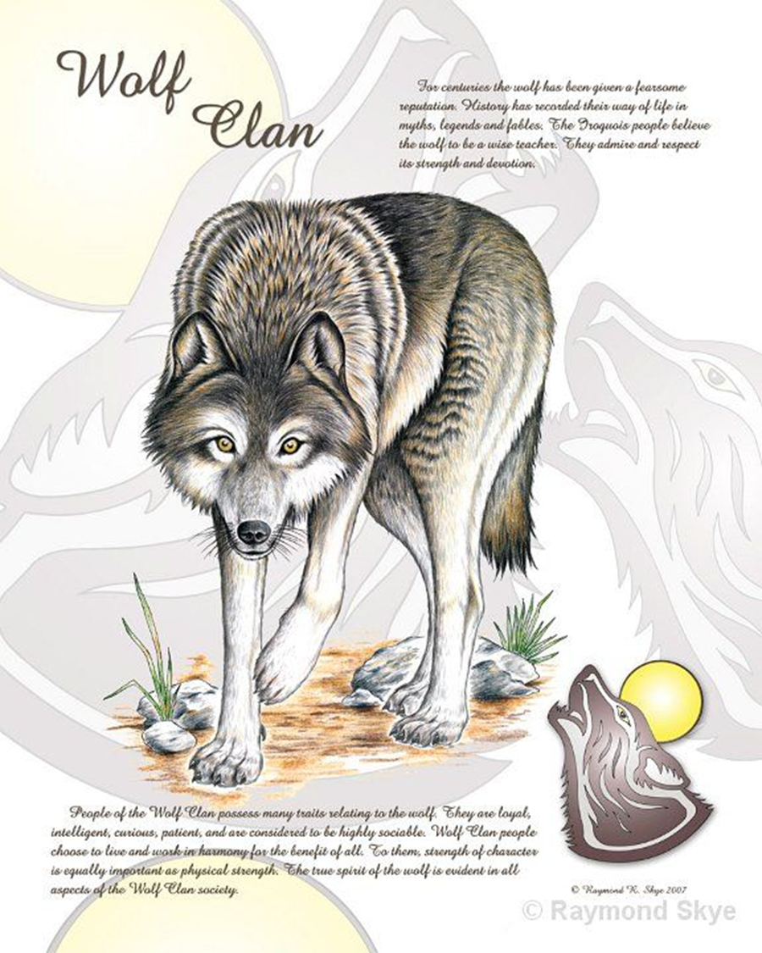
The Halved Whole Reflected Culture-wide
Clan Moieties (Blood-Based)
National Halves (Breath-Based)
Iroquois
Turtle (Blood)
Wolf (Breath)
Iroquois
Youngers (Blood)
Elders (Breath)
}
}
Elders
Younger

Slide 10
Timucuan Dancers, Florida
Engraving by Theodor de Bry, 1591
Halves as Collaboratives
Two Clan Halves (Timucuan)
Red (Blood)
White (Breath)
Each Dancer
Her Footsteps =
Footsteps of Woman before Her
Footsteps of Woman after Her

Slide 11
Iconography of Twinned Cosmos
Seal Township, Pike County, Ohio
Blood
Breath
Name
Blood
Name
Breath
Breath
Name
Blood

Slide 12
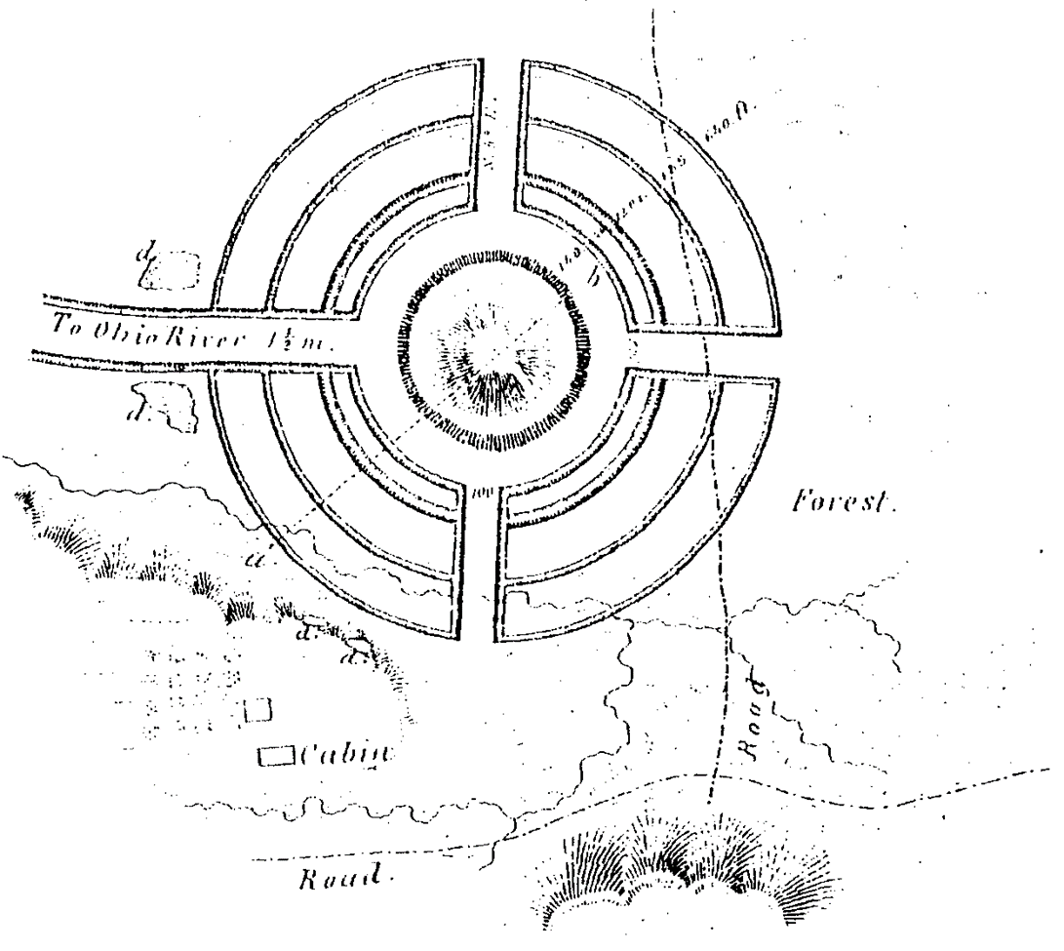
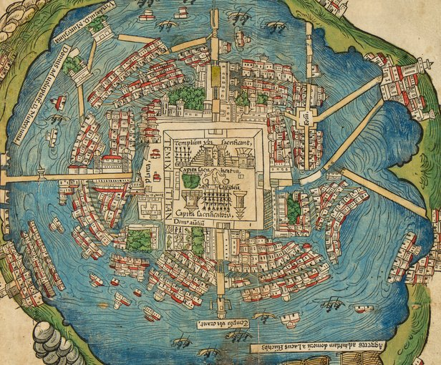
Iconographyof the Twinned Cosmos
Portsmouth Group in Kentucky, Across
River from Portsmouth, Ohio
Tenochtitlán, 1524 Map by Hernán Cortés

Slide 13
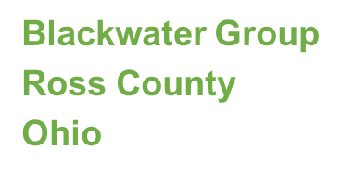
Iconographyof the Twinned Cosmos
Repeating Patterns
Blood
Breath
(Name)
So. . . Must Apply to All Existence

Slide 14
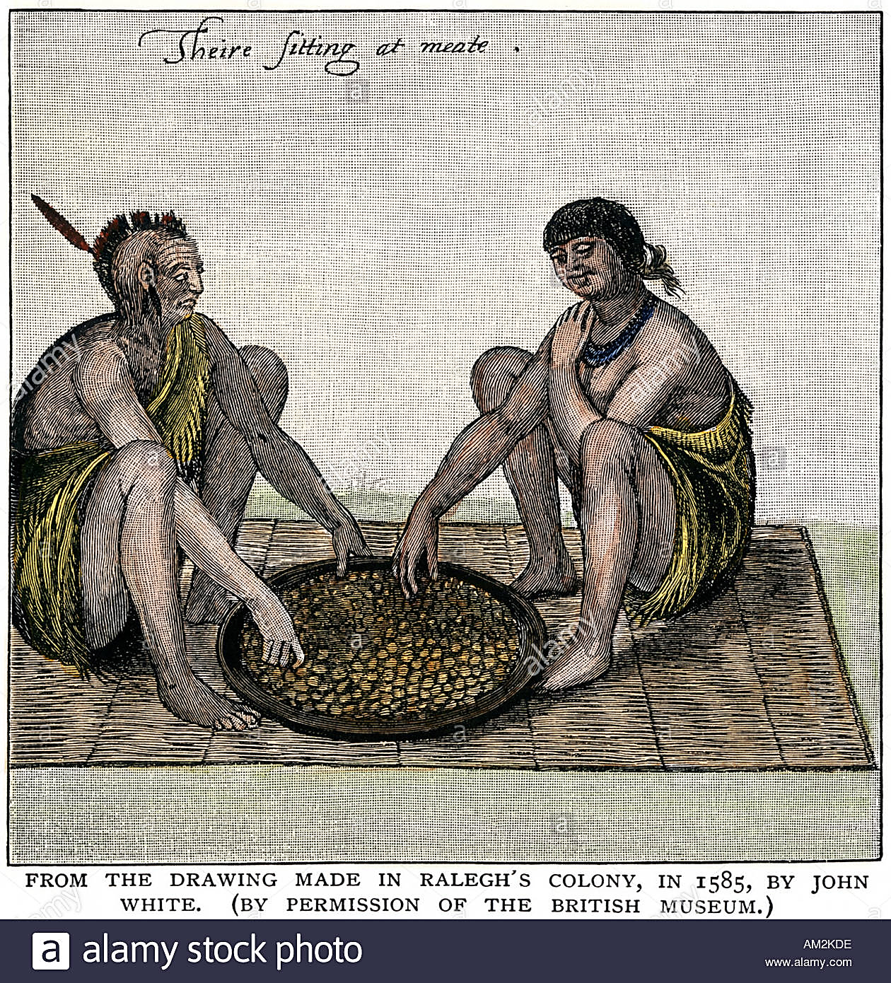
Fractals Must Apply to People
Indwelling
EACH Person Has
Spirit of Blood (from Mother)
Spirit of Breath (from Father)
Plus the “Name”

Slide 15
Some Nations Fractal Out the Halves
Multiple Spirits in Each
An Infinity of Fractals
Lakota Have
Two of Breath
Two of Blood
(Think Four Directions)
(Plus One of Name)
But Wait—
Four Mothers (Blood, Serpents)
Four Winds (Breath, Air)

Slide 16
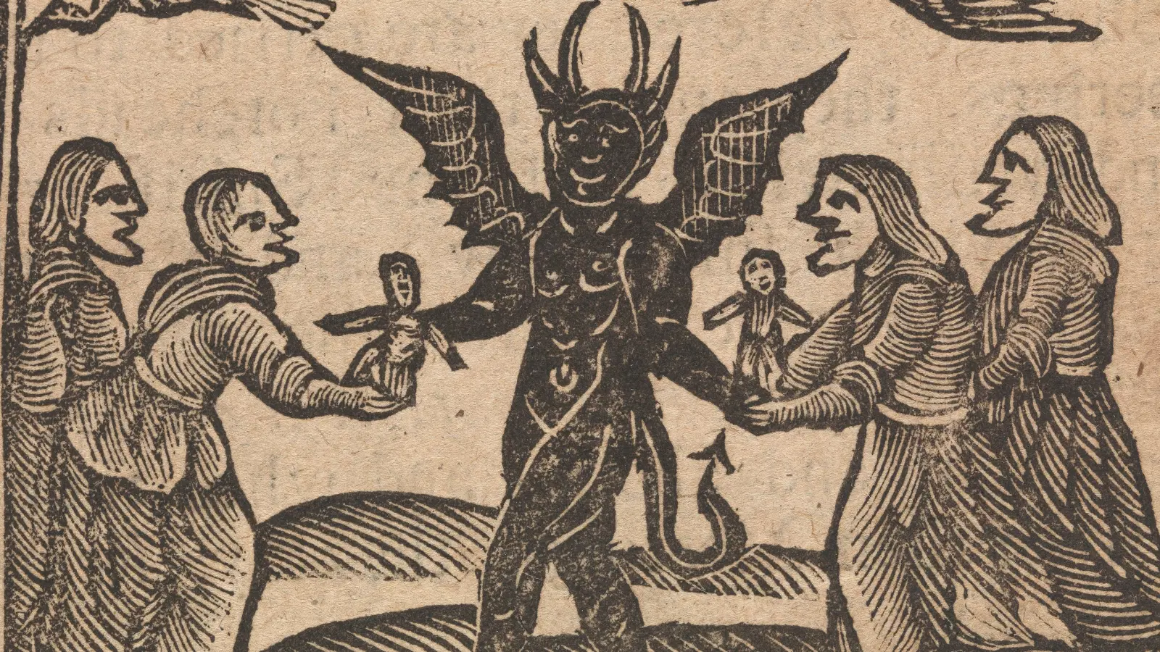
Fractaled halves Account for Missionary Histeria
Missionaries Separate Cosmos
One Spirit per Customer
Western Schema
UP (Sky) = “Good” (“God”)
DOWN (Earth) = “Bad” (“Devil”)
Hence
Breath = “God”
Blood = “Devil”
Multiple = “Familiar” Spirits
Blood = Women’s Sphere
Guess Who Gets to Be “Evil”

Slide 17
AnthroPologists & Historians Followed Suit
One God
One Life
One Spirit per Customer!
Refs to Multiple Spirits
“Informants” Must Be “Confused”
Don’t Known Their Own Traditions!

Slide 18
What Happens When Your Knowledge Is Forbidden?
Some Repress It
Some Forget It
Some Remember a Little
“A little knowledge is a
dangerous thing.”
─ British Proverb
Illustration by Zhou Tao, 2010

Slide 19
The Small Knowledge
Bones, Season 5, Episode 13 (2010), “The Dentist in the Ditch”
“Native Americans believed that homosexuals were of two spirits.”
Indigenous Cultures
√ Always Open to Non-Heteros
√ Had Multiple Spirits
Presto-Chango!
√ Cultural Meme Is Born
“Native Americans believed
that homosexuals were of
two spirits.”
(We did? Really?)

Slide 20
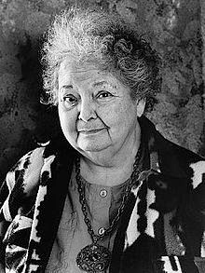
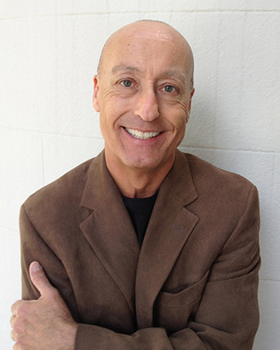
The Two Spirits Morph…
As Appropriated:
Two Spirits = LGBTQ
Known to Be Wrong
Paula Gunn Allen’s Account
Will Roscoe’s Account in Changing Ones (1998)
Paula Gunn Allen, 2007
Will Roscoe 2012 Photo by Cass Brayton

Slide 21
“Two-Spiritedness” Today Among All Those Things We Know for Sure . . .
That Just Ain’t So
Real Tradition
Everyone Has (at Least) Two Spirits
As Fractals of Twinned Cosmos
Unconnected with LGBTQ

Slide 22
= Boundary Crossing ≠ Two Spiritedness
LGBTQ
Boundary Crossers Pass Boundaries Most Can’t Cross
Wow. They Must Know More than the Rest of Us.
We Should Listen to Them.

