Slide 1
The Transformation of the Gifts of Life into Money

Slide 3
We need a diagnosis
We need xray eyes to see the underlying patterns that are influencing our society and our lives here at the End of Time, so we can understand how we got here and what we still might be able to do about it.
In these salons we have been talking about the hidden maternal gift economy and its logic and values that permeate life without our seeing them. Giving – receiving form a theme with many variations, which we usually do not recognize as such because we do not recognize the primacy of giving-receiving.
Exchange (quid pro quo) is one of these variations, and exchange for money is itself a variation on exchange, a variation on that variation of quid pro quo, which is a variation on giving – receiving.

Slide 4
The analyses we have do not suffice to allow us to understand what is wrong because we have left out
1. The maternal gift economy
2. The negative logic of exchange (and we have confused it with gifting)
3.We have not recognized the negative conceptual psycho-social character of money.

Slide 5
We have been talking in these salons about unilateral giving and receiving learned from being mothered as the basic pattern of life and understanding.
It is the inter active pattern or schema through which we experience the world.
We both project gifting upon the world and find its patterns there.

Slide 6
There are many variations on the pattern of giving-receiving
Communication is based on it
Exchange – quid pro quo - is one variation on giving that contradicts it, transforming the logic of the transaction from other-oriented to ego-oriented, creating an altered kind of communication.
Exchange for money is one variation on exchange as such. Money confirms the change in the relation between the interactors – from gift to exchange, while abstracting and generalizing it.

Slide 7
If we put the gift back in the analysis of life from which it has been taken away, we can see that money is strange. It is given but it is not a gift. In fact, as the necessary means of receiving, it contradicts direct giving and it imposes quantification on things we usually buy for their qualities.
I have been thinking about this strangeness ever since I first encountered Marxism in my 20’s and studied it as a young mother.

Slide 8
In my first essays, which were published in the early 1980’s I argued that communication is not exchange. And that money as the mediator of exchange is a kind of one word material language – alienated communication.
I wanted to have our Salon on the gift in language before this one on money because if we don’t see the gift in language, we cant see the linguistic character of money as an alienated material word.

Slide 9
I have written about this a lot in my books though I haven’t spoken about it in presentations or short articles because it take a lot of leading up to, since it is a rather strange idea.
However, I do want to talk about it now because I believe this alienated linguistic character of money makes it into a negative conceptual mechanism and that therefore we must not take it with us into any new society we try to create. In fact, I think it is also a template for patriarchal dominator structures and systems

Slide 10
In fact, monetized exchange, money itself and patriarchy cross-validate each other and other oppressive social configurations, to form a real life conceptual system.
We need to understand them and change them together so that we do not just cut off one head of the hydra and allow the others to continue to operate unchecked as models of successful domination.

Slide 11
Like other male thinkers before him, Marx did not see the existence of the gift economy, though he probably was referring to something like it in the few visions of a better society he gave us as a young man. If gifting and gift value – the value we give to others by nurturing them – had been included in his analysis of the commodity, he would have seen that use value and exchange value are what arise when gifting and gift value are denied. Exchange cancels gifting and places the whole discourse on another plane by requiring the evaluation – the naming I would say – of the product in money.

Slide 12
This naming process abstracts the product from the maternal gift economy and places it in relation to all the other named products on the market that have been produced for exchange. After the products receive their price in money they wait in a store outside of time and use, until they are sold/bought and real money is given up for them.
Marx says that in exchange the relation between things takes the place of relations between people and he sees this as a kind of fetishism. I wondered which relations between people were the ones that the relations between commodities took the place of, and I realized they were the gift relations of mutality and trust we create through gifting.

Slide 13
Alfred Sohn-Rethel (1899-1990) after many years of studying Marx and especially the exchange of commodities and money, conceived the idea of the ‘real abstraction’ that is, of an abstraction on the reality plane. Products’ being named in money and kept out of circulation, abstracted until the real money is given up for them, after which they can be used, and the performance of this odd interaction of exchange as the main relational moment or ‘social nexus’ of human society create a kind of abstract warp in reality that has many repercussions on what we think and do.

Slide 14
Sohn-Rethel registered how strange exchange really was, and how we had to hold the products apart from real life, kept unused in stores while waiting for the transaction to take place. That is, he said there was an ‘abstraction’ that happens in the context of real life, making this strange shared mental procedure exist on the reality plane.
Then Sohn-Rethel showed how Western philosophers have been deeply influenced by this ‘real abstraction’, beginning with the pre-Socratics and particularly referencing Newton and the a priori categories of Kant.

Slide 15
Sohn-Rethel thought that this abstraction on the reality plane actually influenced our thinking to become more abstract, Richard Seaford following on Sohn-Rethel’s ideas shows how the exchange abstraction functioned to change the idea of subjectivity in Ancient Greece and Ancient India at the dawn of coined money.

Slide 16
To my mind the main importance of this idea of the exchange abstraction or ‘real abstraction’ is that it shows how our thinking can be influenced by our social practice that in itself contains a kind of incarnation of our thinking. We have externalized a concept model that is projected back into our minds through our social practice of exchange.

Slide 17
For me – and I believe for Sohn-Rethel - the most mind blowing part of the first book of Capital is Marx’s analysis of money as the General Equivalent
The other functions of money Marx sees are measure of value, medium of circulation and store of value. However, it could not have these without the General Equivalent capacity.
In the same way that a word can stand for many things of the same kind the General equivalent stands for many things and in this process their general ‘meaning’ emerges, which we call their ‘value’.

Slide 18
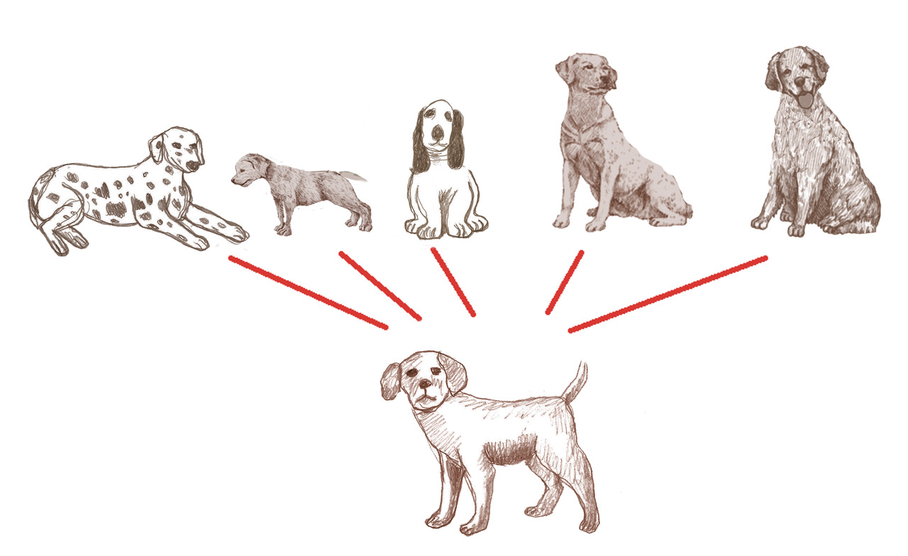
Generalization
We use an exemplar dog in a one-to- many relation to other dogs to create a generalization and to understand a category ‘dogs,’ extracting their common qualities,

Slide 19
This one to many configuration of money to all commodities is similar to generalization, and Marx finds that what all the products on the market have in common is their value – not a physical but a social quality, which is expressed in money, when it is exchanged for each of them singly.
It seems that this idea of generalization and concept formation was accepted until around the 1970’s when other ideas about our mental organization came to the fore such as Eleanor Rosch’s Prototype theory.
However, I would like to emphasize that there are numerous repetitions of the ‘Classical’ generalization form that are played out in society

Slide 20
Many One-to-Many Concept Forms Congruent with the Money Model
Father - family
Owner to properties
General to army
President to population
Representatives to constituencies
Anglos over other races
Colonial powers over the colonized
The ‘true’ religion over others
The 1% over the 99% - in this the money concept model has united with the patriarchal concept model of one man over many.
That is the capitalist isolated individual in front of many like him.

Slide 21
Picture of the General Equivalent.

Slide 22
When we look at these one-to-many social configurations on the backdrop of the gift economy we can see that they are all different ways of taking gifts through power and abstraction – extraction
I believe that they have generalized because money is an incarnation of our mode of thinking in one-to-many concepts, making our thought processes more abstract because it leaves out quality for quantity and displaces gifts and gifting so as to recuperate them on the other side of the exchange transaction.
This becomes a model for one-to- many social structures among us.

Slide 24
Do all these look-alikes of money form a hidden structure within Intersectionality?
I believe they are actually the structure of the parasitism of monetized exchange upon the gifting host, where exchange functions according to (quantitative) categorization itself as well as denial, subterfuge, leverage and force.
The concept model of money suffuses and informs all the other one to many formations and feeds back into the model of the concept itself, making it more abstract and less clear – just because it has an alternative concrete existence… but now it is reabstracting into digital money.

Slide 25
in his book Symbolic Economies published in English in 1990 J J Goux shows many social forms that are similar to money as General Equivalent- Gold, Speech, Monarch, Father, Phallus and discusses them in a Freudian and Lacanian context. The psychological aspects of this and its importance in Patriarchy are essential but I won’t try to go into them here.

Slide 26
Not only is this proliferation of similar structures happening but patriarchy and capitalism have become terribly important in pushing us toward the destruction of the planet under the domination of patriarchal – fascist governments with an overlapping of money mimicking structures that plunder the gifts of Mother Earth for the monstrous benefit of the few.
The endless increase of money creates the human capitalist icons that take the system to ever more dangerous excesses while billions starve or die under expensive bombs and from colonially caused starvation or drown in the seas or die on roads and at hostile borders escaping from death at home, trying to immigrate.

Slide 27
So it is not just money as such but money as an incarnation of a thought process that also feeds back into the thought processes, from the external to the internal - and forward again from the internal to the external.
Money provides a streamlined one to many model. (it is a quo for which each quid must be given) The general social model of the internal generalization-concept-forming- model – displacing other possibilities by its constant embodied use in daily transactions and in the mainly inaccessibile realms of high finance and banking and government expenditures. As such it erodes other possible social generalizations like that of the gifting mother or the gifting earth.
It also gives power over – because (given the invisibility of alternative models) almost anything can be bought including obedience and subservience.

Slide 28
Why is this happening?
Money seems to be a harmless coin or paper bill that we dominate completely, materially, just a social tool we put in our pockets and use for keeping accounts so that everyone gets their fair share.
However, it is influencing us towards abstraction from gifting and towards following its model, becoming like it, an infinitely expandable One at the Top
And this allows us not to see gifting and gifts, while we see only abstract relations among concrete things (which we do not see as gifts)In neoliberalism we think of ourselves as homo economicus and all our economic and comunitary life is turned toward getting ahead, getting to the top, becoming (like) money.

Slide 29
Abstracting from gifting – and from mothers, mothering and children –places the whole realm of the gift beneath that of exchange, beneath in the sense that it is made invisible, unimportant, unrealistic as a way of life, ungeneralizeable and in the context of the market it is penalized and often self sacrificial.
This allows gifting to serve as the host of a parasitic market that functions by invisibly taking gifts as a matter of course.
It does this through the mechanisms of (the gift of)surplus labor into which also flows the value of the unpaid (gift) housework, and the free gifts of nature, non of which are even quantified until the product is sold and then they are named ‘deserved profit’.

Slide 30
Psychology of gifts and psychology of greed
In maternal gifting the giver investigates the need of the receiver and produces or procures something to satisfy it appropriately. Doing this implies the intrinsic value of the receiver for h:er (otherwise s:he would not have given). I call this the implication of ‘gift value’ and it is registered in the receiver as self-esteem.
This seems to have been transferred into an implication of the market – the more gifts of the capitalist can extract, the more intrinsically valuable s:he appears others and to h:erself to be – the more h:er self esteem is enhanced.

Slide 31
Gift value is not seen by economists, who do not see the gifting economy in its own terms – but only as a failed exchange. Even economists of care mainly want to bring the gift economy into the exchange economy rather than transform the economy as a whole toward gifting.
Nevertheless, gift value continues to exist as an implication and motivates many of our actions – which we do in order to receive that implication – even when we are blind to its source in maternal gifting. For example, if receiving the gifts of others implies the gift value – even the intrinsic value - of an individual and causes self esteem- the individual may try to get as many gifts as possible by leveraging, extorting and plundering them even though neither those who are exploited nor the exploiters know this has anything to do with gifting. This would be an explanation of the motivation of patriarchal capitalist hubris and greed.

Slide 32
From this perspective we can see that it is not just an issue of gender that tries to keep women subservient but the need of the parasitic monetized exchange economy to keep the gifting economic host (of which women and especially mothers are the core) invisible, (re) productive and under control.
Capitalism is Patriarchal just for that reason, that Patriarchy(in league with money) dominates the gifters and blinds them to their own oppression while making them dependent upon the parasitic market mechanism to provide them (through their own jobs or those of their family members – who have been nurtured free by them) with the means of giving.

Slide 33
Because market exchange has taken over and permeated almost every aspect of our lives and is now inserting itself into our conscious and unconscious minds through internet advertising and surveillance, we barely protest and embrace it as real and normal, the way things are.
As the mediator of exchange, money is omnipresent, but it is also omnipresent as the store of value in immense holdings of capital that form the backdrop upon which the lives of rich and poor proceed.
As such it has the potential for a huge influence over the way we think and what we think.
I believe it is up to those of us - women particularly – who are not altogether caught in the market processes and who are not making ourselves in the image of money – to think our way out of these boxes and embrace the gift economy and its values for the good of all.

