Slide 1
The Gift of Truth in a World of Lies

Slide 2
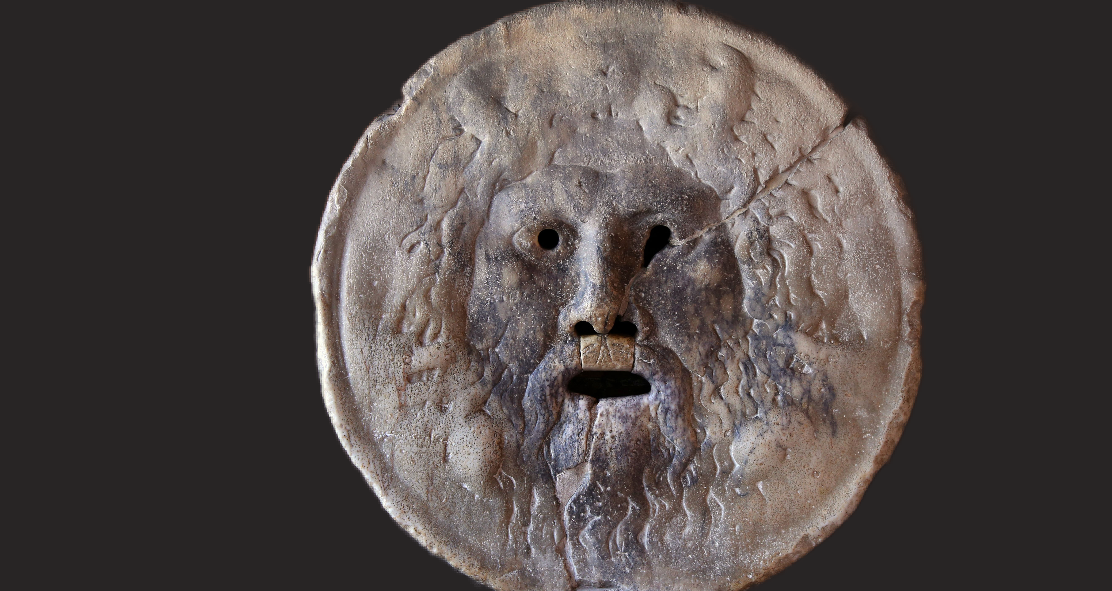

Slide 3


Slide 4
Why we are in a world of lies
We have become unmoored from the maternal gift economy which provides true nurturing at the material level . Otherwise the child suffers and dies.
This elimination of the importance of mothering-gifting economy from our consciousness allows us to live in a world of lies of ‘omission’ and ‘commission’in which we see lying as only an individual defect of dishonesty not as an important characteristic of an entire ego oriented system.

Slide 5
The economic lie
In order to know and be able to bring the gift of truth in this situation it is important to realize that the market has been exploiting gifts for centuries. That is its purpose. However it presents itself as benign.
Therefore there is already a background of lies in which we operate today and though people may have the experience of truth in their private lives, the public sphere is deeply altered and those reponsible for it become engaged in its falsified ways of communication.

Slide 6
Moreover ego-oriented Patriarchy is integrated with Capitalism and combines with exchange to create practical and abstract structures of domination in which the people below must give to (nurture) those above. The reception (of the unrecognized gifts) of profit is the motivation of the whole gift-denying-and-appropriating system.

Slide 7
The gift of the maternal gift economy is other orientation, alter-centrism, attending to the needs of the other – the child. It is the gift that is necessary for knowing the truth and being able to act accordingly.

Slide 8
Daniel Ellsberg, who recently died, said this about the Pentagon Papers
“I don’t think there is a line in them that contains an estimate of the likely impact of our policy on the overall casualties among Vietnamese or the refugees to be caused, the effects of defoliation in an ecological sense. There’s neither an estimate nor a calculation of past effects, ever.”
And he added: “The documents simply reflect the internal concerns of our officials. That says nothing more nor less than that our officials never did concern themselves with the effect of our policies on the Vietnamese.”

Slide 9
How can a national government act this way?
And we have seen the same deception and lack of compassion in Iraq and Afghanistan, Syria and Yemen but also in the many other interventions in the Middle East and world wide.
Our laws of commercial globalization also allow us to ignore the damage our corporations cause in the many countries they exploit.
But see for example the positive case of US lawyer Stephen Donziger’s suit against Chevron in favor of the Indigenous people of Ecuador.
Even in these days we have seen the public attention given to 5 people who died in the Titanic viewer submarine while 700 people who died in the immigrant boat sinking in the Mediterranean were given less attention

Slide 10
That boat sinking in the Mediterranean is not unusual at all, boats full of immigrants have been sinking there for a long time usually without even being mentioned in the international press and only occasionally by the Italian presss.
An Italian group counts 26,000 drownings in the last 10 years but there are probably many more
One Italian man living on an island there wrote “Fishing used not to be good here because the fish did not have enough to eat. Now, since there have been so many boats sinking nearby, the fish have come back.

Slide 11
It is clearly the lack of orientation towards the ‘other’, responsibility towards the ‘other’, even interest in the ‘other’, that causes this lack of concern, the inability even to say it is happening.
Where does this self-absorbtion at the individual, the national and the international level come from?
And where does the desire and the ability to give the gift of truth about these devastating situations come from?
I believe it is not a moral issue but an economic issue. We interpret as moral choice or flawed human character something that actually comes from the economy we practice every day.

Slide 12
The lack of other-orientation comes from the elimination of unilateral gifting from the public mind - the zeitgeist - because of the hegemony of the exchange economy and because of the widespread individual ego structure that is influenced by exchange. The whole system of Capitalism too is reponsible for this ego centrism but without the gift denying logic and interaction of commodity exchange itself with money at its cold heart, capitalism would not exist.
With this in mind we can see that compassion is the basis of truth telling on the large scale and the lack of it allows us to lie.

Slide 13
In spite of all this there is one area of capitalism that has to function directly according to the gift economy, and that is the so called ‘domestic sphere’. Young children require unilateral gifting to them by their motherers because they cannot give back an equivalent for what they have been given and they do not even begin to understand exchange until they are around three years old. Their complete understanding and integration into the system does not happen until their teenage years. Most women continue to do free gift work and nurturing in the home throughout their lives.

Slide 14
Our understanding of the human being – of what life is – what our own lives are – is deeply flawed and misleading. We call ourselves ‘Mankind’ because we leave the universal mother-child gift-giving -and-receiving experience out of our concept of the human.
This elimination is already a falsehood that we in the ‘West’ have accepted for centuries.
Even if, with feminism, more equality of women with men has been achieved, this is equality within a group that has eliminated the mother-child model from its own conscious identity

Slide 15
Recently Sarah Blaffer Hrdy, Wendy Trevathen and others have suggested that mothering and even grandmothering were at the origin of human evolution in communities in prehistory. The title of their edited book Costly and Cute, Helpless Infants and Human Evolution expresses this hypothesis.

Slide 16
Unilateral gifting is necessary for mothering because the baby or young child cannot give back an equivalent of what she has been given.
This requires motherers to understand and attend to children’s needs, satisfying them with something appropriate.
I call this unilateral gift giving and I believe it creates the interactive interpersonal patterns of meaning that are the underlying matrix of everything that comes afterwards: language, our understanding of our surroundings, family and community relations and last but not least this matrix is the foundation of the economy. The quid pro quo exchange economy is just a distortion of the unilateral gift economy, but this distortion creates totally different motivations and effects.

Slide 17
The elimination of this maternal model from our idea of economics and from our worldview has allowed us to absorb gifting into the market and exploit it – that is to take gifts and not recognize that we are doing it. This is in itself a widespread and fundamental lie, a bedrock of mendacity upon which many other lies can be built. For example we believe TINA – There is No Alternative - to the market, when in fact the alternative of the gift economy constitutes the essence and aim of the market – profit. The unpaid surplus labor of workers, the gift of the unwaged work of women in the home and the gifts of ‘nature services’ are given by all to the Capitalist who does not pay for them and thus for him or her, they are free, though s/he calls them h/er ‘earnings’, ‘profit’, or money s/he has ‘made’.

Slide 18
This is a situation of parasitism in which the giftgiving host does not recognize that she is giving to the parasite because she is dependent on it for h/er capacity for life and for nurturing life. Nor does the parasite recognize and take responsibility for its parasitism. In a way this is a system of mutual deception and self deception.
If we recognize that the exchange economy is draining away the gifts of humans, other species and the planet, the still healthy gifting being in all of us can dismantle the parasite,while understanding the needs for peace and maintainance of life that we can fill, which will allow us to save as much as possible of this endangered humanity, all the other species and the continually giftgiving Earth.

Slide 19
Not recognizing the system of market parasitism and the gifting host, allows free rein to the lies by which the system defends itself. Therefore it is not surprising that commercial lies, political lies and ideological lies are normalized especially in these neo liberal times.
On the other hand altruism appears to be almost inhuman, a pose, a self congratulatory appeal to exceptionalism and saintliness.

Slide 20
Exchange
The logic of quid pro quo exchange began to be practiced explicitly in Europe with the invention of money around 600 BC and became an abstract model that contradicted and gradually pushed aside both peaceful matriarchal relations and patriarchal violence. Monetized exchange made inroads into individual and community relationships, which had been based first on the generalized maternal satisfying of needs together and then on Patriarchal dominance by force. With money there was a possibility of a different kind of equality and value, a different model.

Slide 21
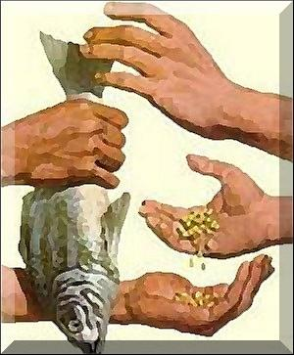
X anount of money = Y amount of product
Notice the symmetry

Slide 22
While mothering-gifting gives value to the child
And Patriarchy proves the superior value of one by dominating others,
Exchange seems to provide a different kind of evaluation, where the standard is the equality of objective quantitative value among things.
In Capitalism this has morphed into a kind of equality that we use to evaluate people: the quantitative equality of the value of things.
Every time we exchange we assert this kind of quantitative commodity exchange equality instead of the qualitative equality of mother and child that we assert and create by giving and receiving. As Marx says, the relations between things take the place of relations between people.

Slide 23
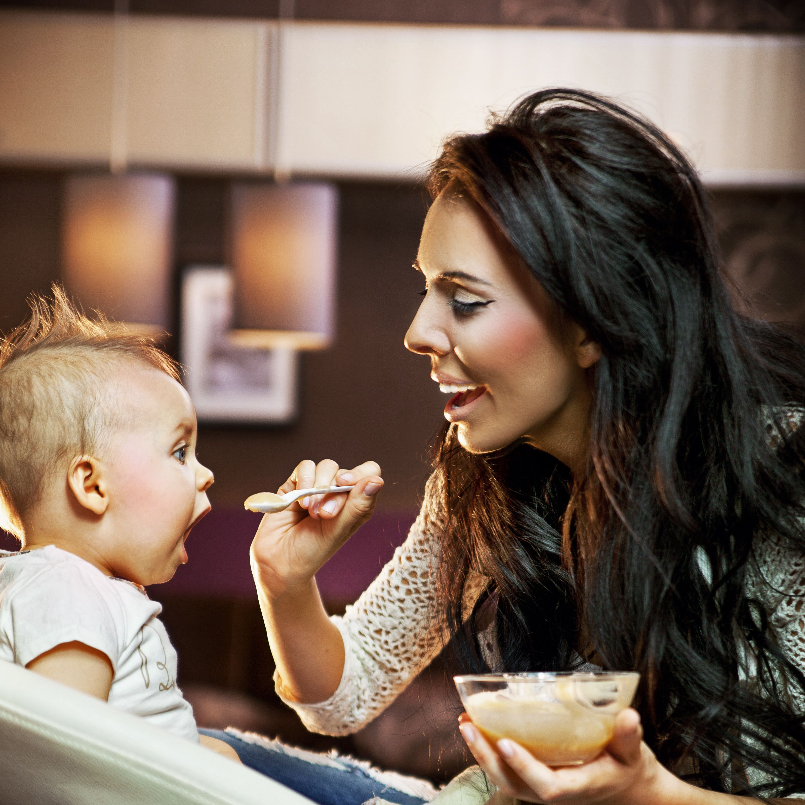
Exchange is profoundly different from establishing qualitative equality or similar identity between mother and child in daily life.
‘Mirror neurons’
‘Like-me bridge’
Personal real-life interaction
Functions by other orientation
Nurturing gives value to the receiver

Slide 24
In Patriarchal Capitalism quid pro quo commodity exchange begins to be understood and to partially replace mothering- gifting as the model of human interaction starting around age three.
Bribes like ‘If you eat your dinner you can have desert’ or punishments like ‘You broke the cup go sit in the corner’ prepare the child for quid pro quo exchange.

Slide 25
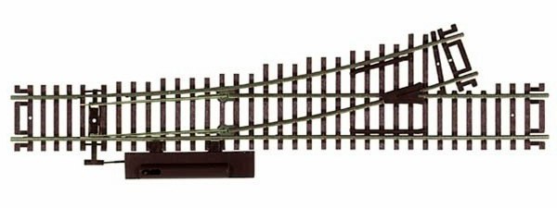
For children a second relational track (of quid pro quo exchange) briefly, though repeatedly, replaces the original track of gift economy relations and later, with the older children’s participation in the market, and then as adults, it becomes the main economic relational track, though the gift track continues unrecognized.
Mother and child gift track
switches to exchange track.
Mother and child gift track
switches to exchange track.

Slide 26
The black box next to the train tracks in the picture contains the ‘switch’, the hidden mechanism that makes us change our relational economic pathways from gift to exchange.
Infancy research shows that babies identify with their motherers, mirroring them kinetically and with their mirror neurons, formimg their own identities in these interactions.
I believe the equation between commodities and/or between commodities and money repeats this kind of identification at a material level. Instead of establishing a commonality though as happens in the mother –child relation, one commodity takes the place of the other and only a quantitative exchange value assessment is given.

Slide 27
If this intuition of mine is true it would explain why exchange has such a widespread influence on us and why people who have lived in gift economies often pick it up immediately when they are introduced to it.
It is not because exchange just comes naturally to humans that it is so widespread but that it is a repetition on the material plane of the basic mother-child interaction. This transposition would have a number of consequences that transform the interaction’s interpersonal character and logic from other oriented to ego oriented (the black box containing the switch of the train track)

Slide 28
Some Other Aspects of Exchange Are:
The proof in reality that the objects undergoing the process of exchange are not given as gifts.
This removes them from the maternal gift economy at least for the moment and other rules apply.
On the market, the products are not directed to any specific person, so they do not imply the value of the receiver as a gift would. The products are assessed as to quantity of ‘exchange value’ with respect to all the other products on the market. Somewhat differently from gifting, this requires attention to the general categories of the products and how they are produced.

Slide 29
In order to be sold the product is held in a store, un-used and un-gifted, waiting to be exchanged. As Sohn-Rethel says, it is abstracted from use and thus provides an everyday model of abstraction that has influenced our thought processes in the West since the beginning of money in 600 AD.
Sohn Rethel called this process “the exchange abstraction” and saw it as influencing abstract science and philosophy. Here again exchange influences what we see as the truth because abstract science leaves out the maternal gift economy.

Slide 30
The general situation in which we are all living now is itself duplicitous.
Gift and exchange continue to run parallel as (unrecognized) patterns- the original train track persists alongside the exchange track throughout life in Capitalism. They are not equal however, because (to mix metaphors) the exchange track extracts the gifts of the maternal gift track.
Gifting continues to exist in the gift economies among those surviving Indigenous peoples who have not been assimilated into the settlers’ way of life and have not had all their original gifts extracted. Yet the settlers’ economy continues to plunder what the Indigenous people still have left.

Slide 31
Even if mother-child other orientation is displaced by exchange based ego orientation, it is not destroyed. In fact it is still present throughout life at all levels of nurture and care including communication and language, which require us to tune in to the communicative and cognitive needs of others whatever place in society we have. This allows us to know how to speak the truth to others and how to detect lies.

Slide 32
A re interpretation of life according to the gift must be made but let me just say here that this (m)other worldview is possible.
The gift of the truth is part of the motherworld view because it satisfies the need of the other to know reality as far as the speaker can tell it. And it also satisfies h/er need for the sincerity of the speaker.
However at present the construction of lies that is patriarchal capitalism already makes the truth hard to discern and anything that effectively challenges the construction is punished.

Slide 33
Categorization
The mother constructs a common gifting relation of qualitative similarity with her child and gives her value
Exchange constructs only the common relation of the products to each other as to exchange value in comparison to money, the General Equivalent. That is, exchange is based on categorization while maternal gifting is based on interactive practice.
Exchange relations override maternal gift relations because they are more general and less individual and because in Capitalism they are often necessary for gifting to be possible. Private property and the private ownership of the means of production, make it necessary to buy the means of gifting.

Slide 34
The gift of the truth is the gift of our human operating system, which derives from the maternal gift economy
Categorization divides up the field of knowledge like private property divides the terrain of the commons. Each category is what it is in that it is not the others.
Thus morality is understood as a category of right action and satisfying the needs of others seems to be moral, an individual virtue. This is not true.
As I have been saying, satisfying the needs of others is the basic mode of the pan human maternal gift economy, and provides the underlying logic of our species, which is grounded in epigenesis as the replication of the care we receive.

Slide 35
The idea that we have of humanity now that eliminates the model of mothering also interrupts our continuity with Mother Earth. Rather than seeing our own needs as adaptations to her gifts, that is, seeing her environmental niches as gifts to which our needs have evolved and adapted, physiologically and socially, allowing us to receive them through work and ingenuity, we see them as potential commodities to be traded on a gift-denying and plundering market.

Slide 36
A wider horizon opens up when we embrace the gift paradigm so that we can see ourselves as part of nature and the Universe as well as part of the human community of homo donans, the gifting being.
This is also a gift of the truth.

Slide 37
Some important truth tellers
Vandana Shiva, the women of Code Pink, Medea Benjain, Jodie Evans, Clare Daly, Jennifer Harbury, Greta Thunberg, Julian Assange (may he be freed!!), Chelsea Manning, Edward Snowden, Chris Hedges, Rev. Cornell West, Noam Chomsky, Glen Greenwald, Gabor Maté, Aaron Maté, Scott Ritter, Michael Moore, Bill McKibben. And there are many many more both internationally and within the USA.
There are numerous groups of truth tellers in different areas and many anonymous activists who speak truth to power together and seperately. There are many people internationally, Indigenous people and oppressed people everywhere who give the gift of truth and are often punished or even asassinated for it.
All of these people demonstrate that the gift of the truth is still present in all areas and that it is making inroads in the zeitgeist of lies..

