Slide 1
ECONOMICS Gift v. Raiding Models The Quick-’n’-Dirty Tour
Barbara Alice Mann, Ph.D.
Professor Emerita, University of Toledo
November 29, 2024

Slide 2
GOAL OF ECONOMICS
Group Prosperity

Slide 3
Economic Considerations
Achieving Prosperity
Production
Consumption
Distribution of Wealth

Slide 4
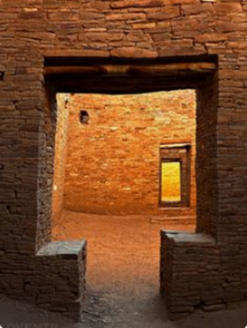
Culture Determines Economic Style
Basic Types
Raiding Economics /~ Patriarchal
Gifting Economics /~ Matriarchal
Cultural Development
Cultural Interaction
Restructuring

Slide 5
Basic Types ● Raiding Economics / ~Patriarchal ● Gifting Economics / ~Matriarchal

Slide 6
Manner of Achieving Production
Creation of Goods
Egalitarian Participatory
Hierarchically Forced

Slide 7
Manner of Achieving Consumption
By Those Who
Can Afford It
Hierarchical
by Class/Caste Restriction
Egalitarian
Shared around Circle by All
By All

Slide 8
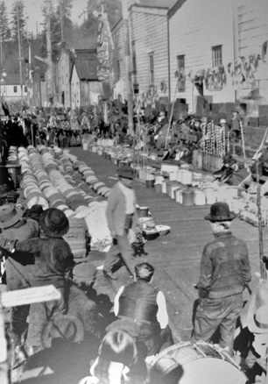
Distribution of Wealth
Hierarchical
Upward by Class/Caste
Egalitarian
Circulated within Gifting Circle
Need-Based

Slide 9
Cultural Development

Slide 10
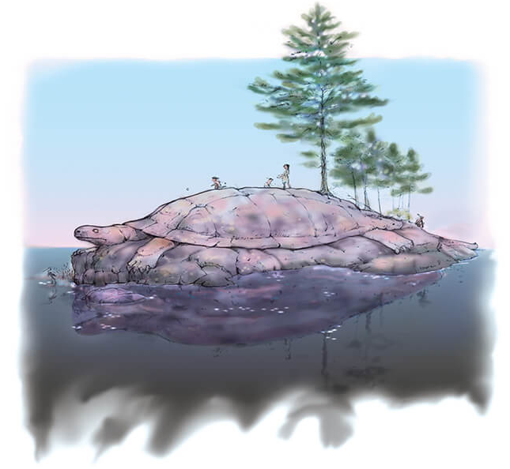
Cultural Premises Determine Type of Economy
Egalitarian
Multiple Spirits
Hierarchical
Single High God
Top: https://www.oneidaindiannation.com/?s=creation+story&lang=en
Bottom: Detail, “God.” Dome fresco by Johann Michael Rottmayr; Karlskirch, Wien, Austria (1715).

Slide 11
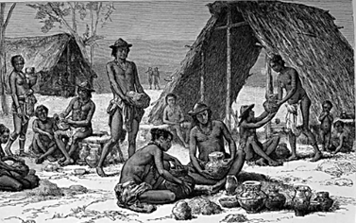
Culture/Economy Pairs
Egalitarian/Multiple Spirits
Gift Economy
Hierarchical/One God
Raiding
Top: Illus., D. Maillart, from Jules Crevaux, Voyage dans l’Amérique du Sud, l’Intérior des Gayanes, 1876-1877 (1883) p. 13 Bottom: H. D. M. Spence, The Book The Church Of England: A History For The People, vol. 1, 1897, illus. “A Viking Raid,” p. 353.

Slide 12
Gift Economy over Time
1142
5 Nations
1730
61
Affiliated
Nations
Add to the Circle
Circulate More Goods
Top: Lafitau, Moeurs des sauvages ameriquains (1724), vol. 2, p. 314, Pl. 15; Bottom: Map of the Louisiane (1730, Archives Service Center, University Library System, University of Pittsburgh, Pittsburgh, PA

Slide 13
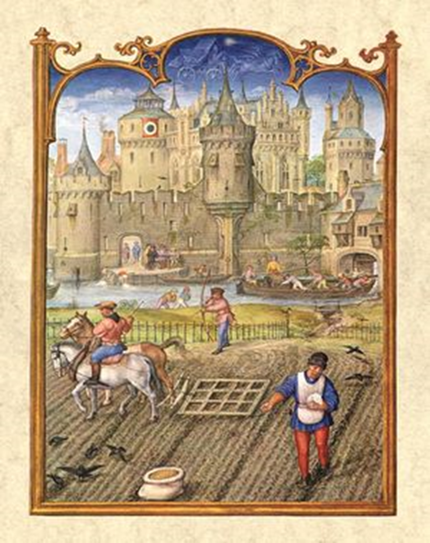
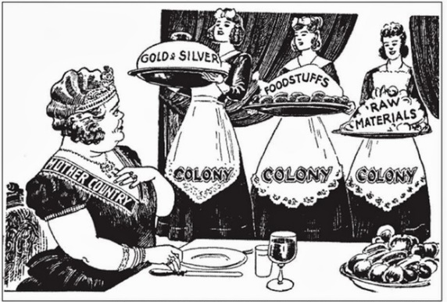
Raiding Economy Over Time
Direct Raid
Indirect Raid (Permanent Raid)
Feudalism
Mercantilism
Capitalism (Mercantilism on Steroids)
Africa
America
India
Top: Breviarium Grimani, 1510–1520, Illus. of Feudal Social Classes;
Bottom: Philip Dorf, Our Early Heritage: A Visualized Text in Ancient and Medieval History , (1940), Illus. p. 285.
Engl;and

Slide 14
Cultural Interaction

Slide 15
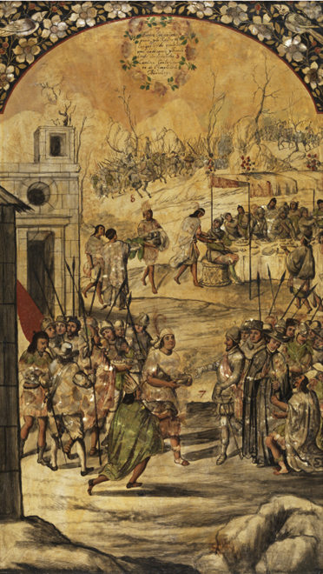
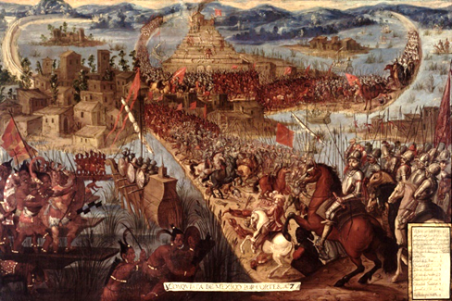
Gifting Culture Meets Exchange Culture
Too Bad about the Flowers
BAM!
Gift Culture Response
Greet with Gifts
Add Newcomer to Gifting Circle
Exchange Culture Response
Take Gifts
Attack
Add to “Colonies”

Slide 16
Raiding the Commons

Slide 17
It’s Not Nice to Raid Mother Earth

Slide 18
Restructuring

Slide 19
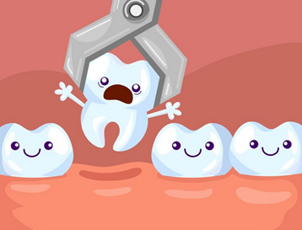
Restructuring
Well, This Isn’t Working
Extraction Mentality
The Problem
Not the Cure

Slide 20
The Peanut Gallery SPEAKS
Put It Back the Way It Was
Return to Terra Preta Economics
Kate Raworth’s “Donut Economics”

Slide 21
Terra Preta: Black Earth Economics
Return to Native American Economics
Small Communities
Ag Based
Gifting Circles
Carbon-Enrich Soil—On Purpose
Untended
Oxisol
Terra Preta
about 4’ Deep

Slide 22
Kate Raworth Doughnut Economics: Seven Ways to Think Like a 21st-Century Economist (2017)
“Donut Economics”
Outer Edge: Eco-Limits
Inner Edge: Social System
i.e., How To Stay within Earth’s Carrying Limits
The Doughnut of Social and Planetary Boundaries (2017)

Slide 23
Model Comparisons
Look, Mom!
The Flo!wers
Are OK!
Activity | Result | Raid Model | Gift Model
Militarize Production | Raids on Creators | 🗹 | ☒
Communalize Production | Gifted Goods Circulation | ☒ | 🗹
Consideration of Earth | Renewal of Raw Material | ☒ | 🗹
Hierarchy Fabrication | Depletion of Raw Material | 🗹 | ☒
Egalitarianism | Support for All | ☒ | 🗹
Top: https://st2.depositphotos.com/1906135/48970/i/450/depositphotos_489707826-stock-photo-abstract-painting-mystic-womans-mask.jpg

Slide 24
Thank you

